Slide 1
Ultrasound of Vascular Malformations
Hansel Otero, MD
Children’s National Medical Center

Slide 2
Kollipara R. Current Classification and Terminology of Pediatric Vascular Anomalies. http://www.ajronline.org/doi/abs/10.2214/AJR.12.10517

Slide 3
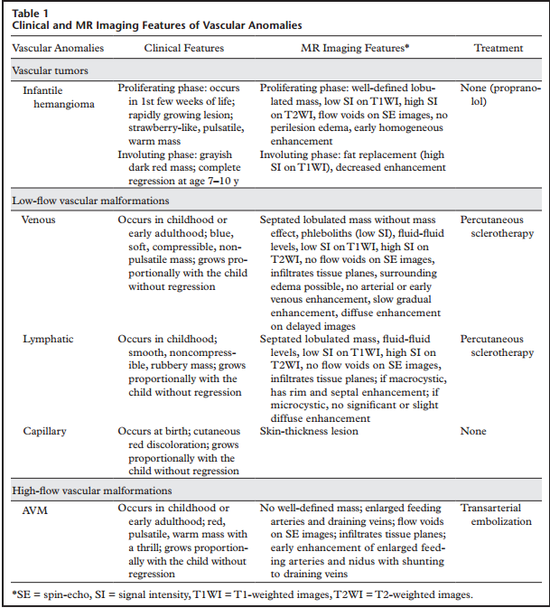
RadioGraphics 2011; 31:1321–1340

Slide 4
Working Classification
  Highflow:
  Hemangioma
  Arteriovenous malformation
  Arteriovenous fistula
  Low-flow:
  Capillary malformations
  Venous malformations
  Lymphatic malformations
http://ac.els-cdn.com.proxygw.wrlc.org/S0033838911001291/1-s2.0-S0033838911001291-main.pdf?_tid=39990c66-24f5-11e5-8d24-00000aacb360&acdnat=1436307315_0d7488760b055e3884540d44dcd8cfd2

Slide 5
Kollipara R. Current Classification and Terminology of Pediatric Vascular Anomalies. http://www.ajronline.org/doi/abs/10.2214/AJR.12.10517

Slide 6
Slow Flow Lesions
Multilocular cystic lesions
Fluid levels or internal echoes
Congenital and not mitotically active
Grow with the child
Lymphatic malformation
Micro- or Macro- cystic
65% at birth and 90% by 2 years
Rapid growth: hemorrhage or infection
Often cross fascial planes
No Flow. No change in size with Valsalva
Venous malformations
Most common VM
Not clinically apparent until childhood or adulthood
Enlarge during puberty (hormones)
Superficial lesions: bluish color skin
Isolated lesions (eg within a muscle)
Changes size w/ valsalva or position
Compresses (spaces get smaller)
Slow flow (change settings)
https://www-clinicalkey-com.proxygw.wrlc.org/#!/content/playContent/1-s2.0-S0887217114000419

Slide 7
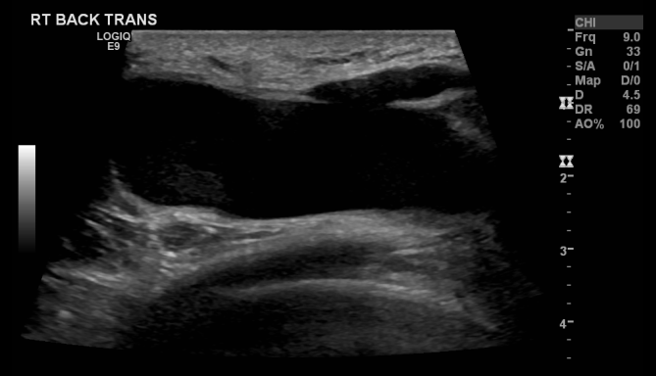
Lymphatic- 2466665- tx

Slide 8
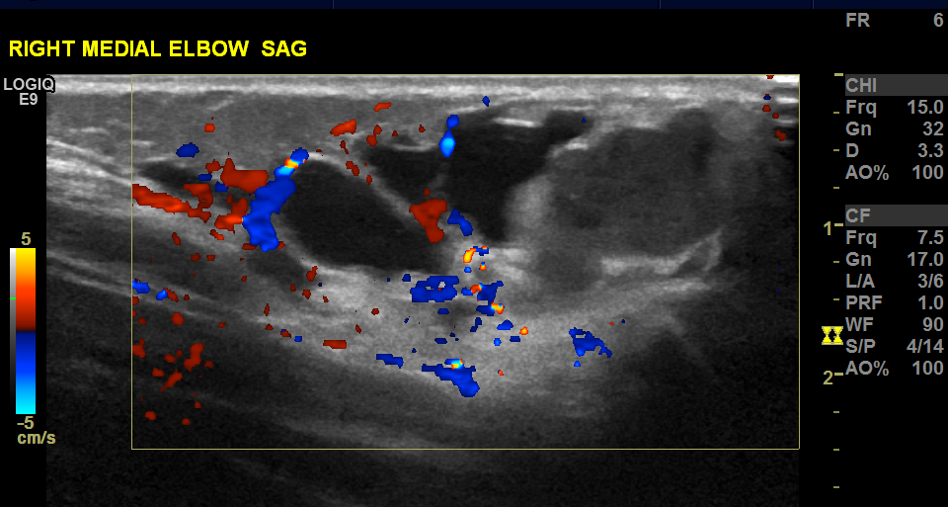
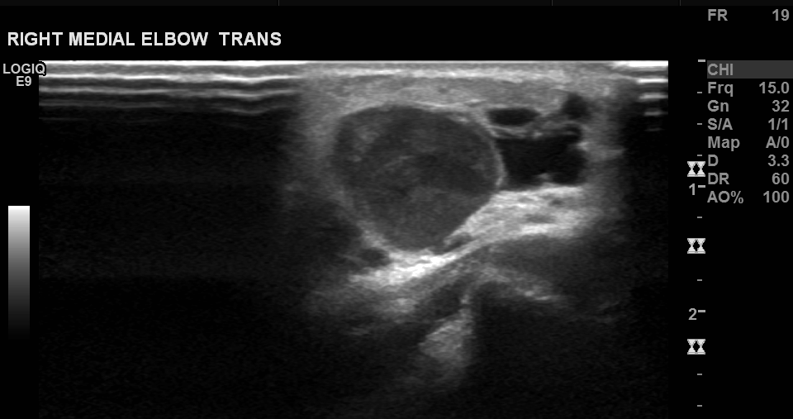
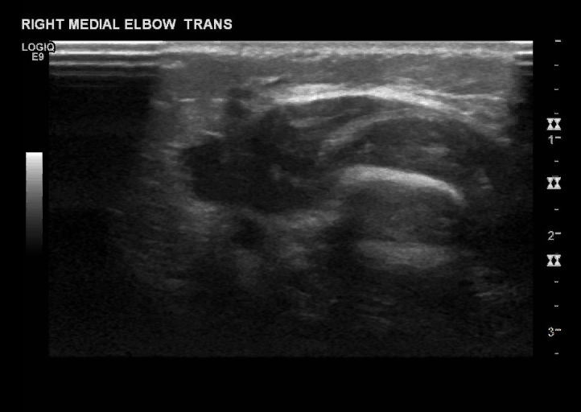
Lymphatic w/ Hemorrhage - 2743723
Notes:
2743723

Slide 9
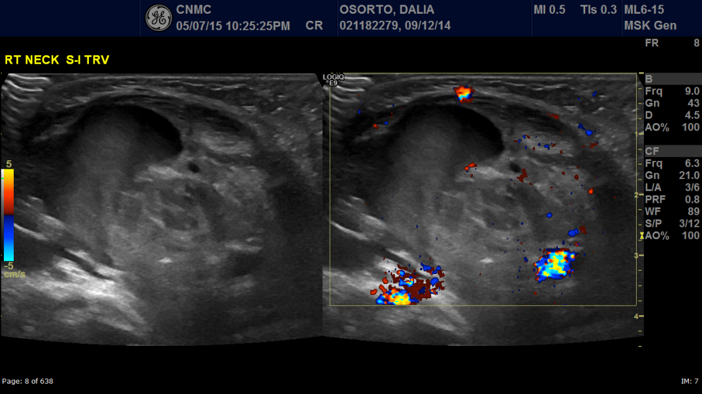
Lymphatic w/ Hemorrhage – 2779671- tx
Notes:
2779671

Slide 10
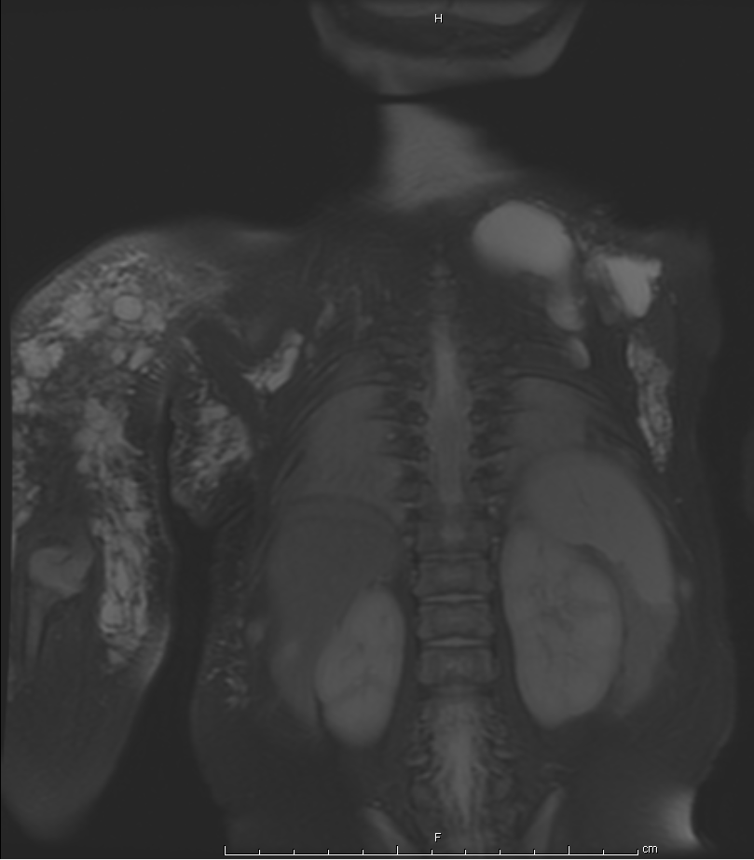
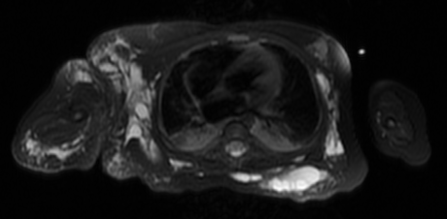
Lymphatic w/ Hemorrhage - extent
Notes:
2779671

Slide 11
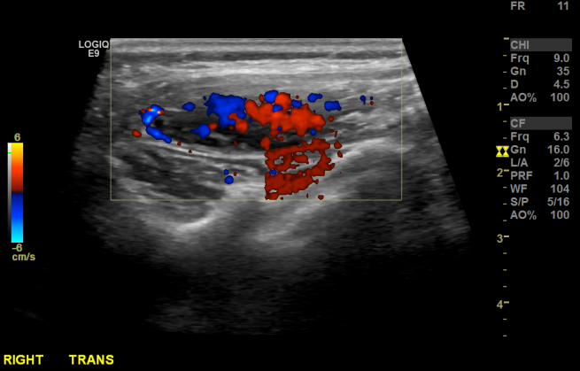
Venous M- 2649825

Slide 12
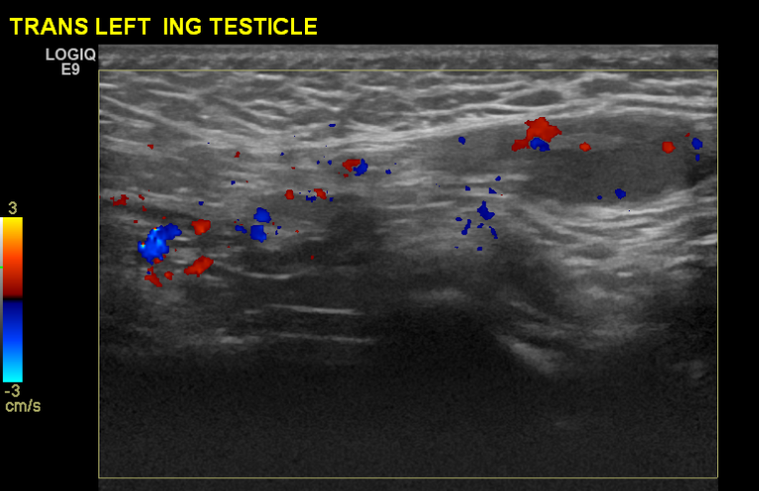
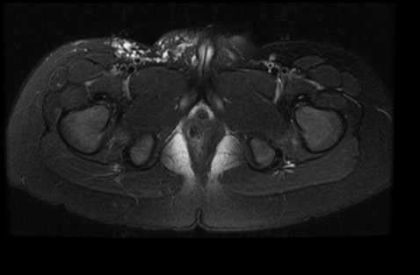
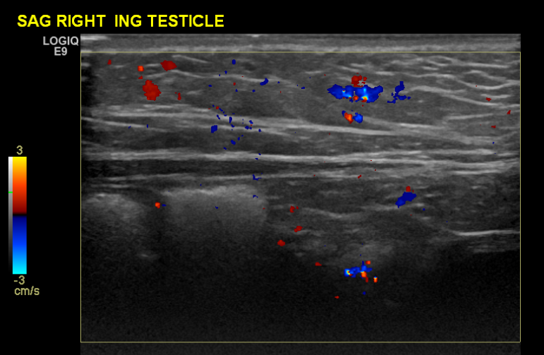
Capillary Malformation- 2308887
Notes:
2752414

Slide 13
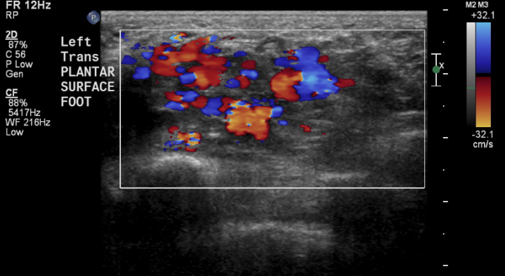
Foot AVM- 2738140- tx

Slide 14
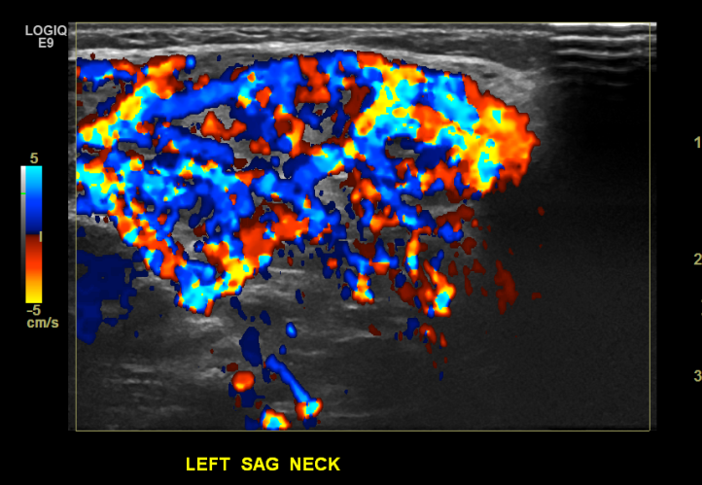
Hemangioma- 2760553

Slide 15
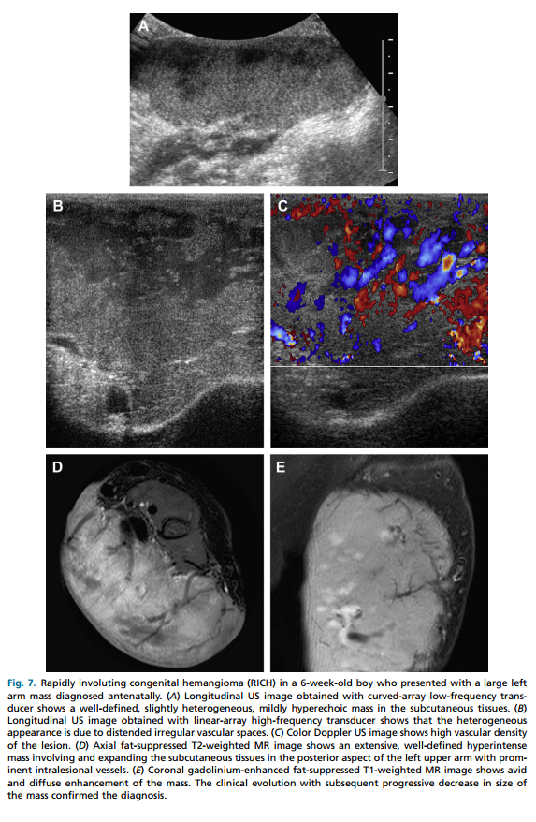
Hemangioma

Slide 16
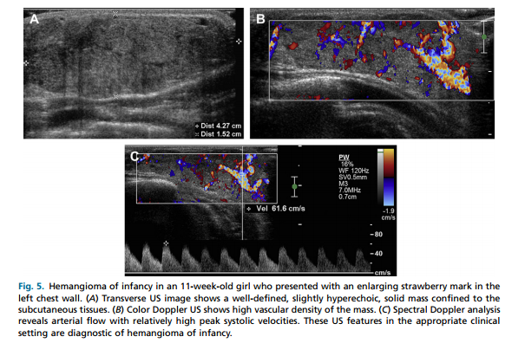
Hemangioma
http://ac.els-cdn.com.proxygw.wrlc.org/S0033838911001291/1-s2.0-S0033838911001291-main.pdf?_tid=39990c66-24f5-11e5-8d24-00000aacb360&acdnat=1436307315_0d7488760b055e3884540d44dcd8cfd2

Slide 17
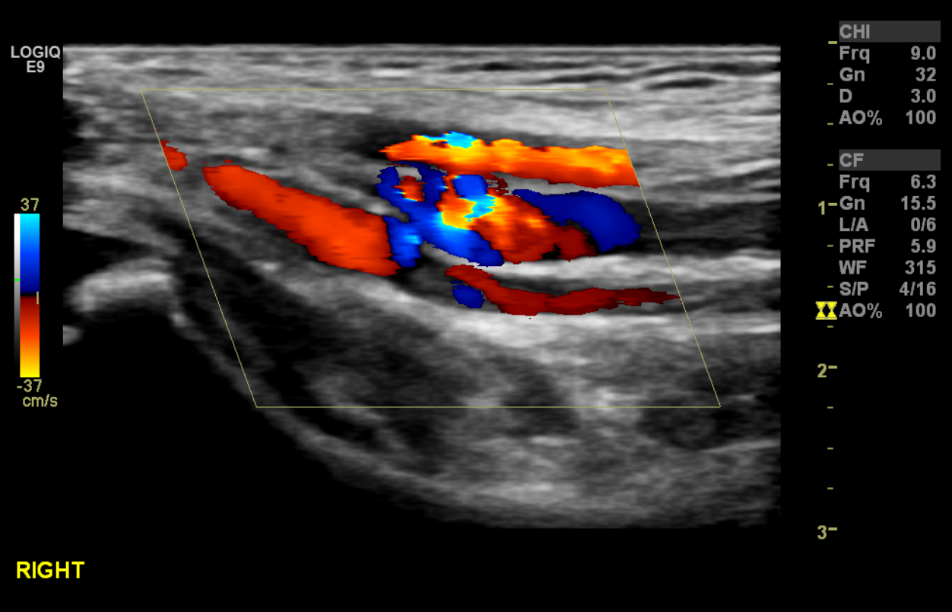
AV Fistula-

Slide 18
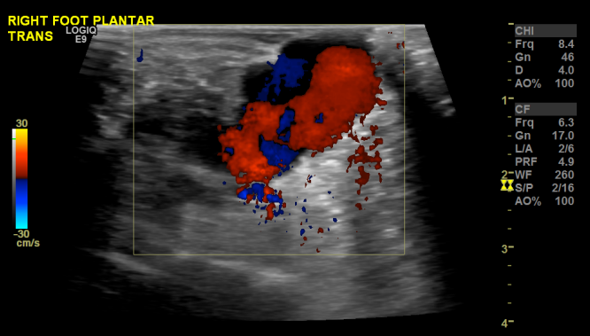
Pseudoaneurysm- 2661850

Slide 19
What I…
NEED (Would like):
Skin color
Pain
Across fascial planes/ deep tissue invasion
Spectral Doppler
Feeding artery/ draining vein
Phleboliths
Don’t care about:
Size of lesion
Size of the largest cyst
Nearby large artery/vein
Debris

