Slide 1
A problem based approach to learning shoulder ultrasound in a pediatric patient.
Darragh Brady MD, Jonathan Zember MD, Ramon Sanchez MD
Children’s National Hospital, Washington, DC
Notes:
New logo
You may submit 35 slides or less.
File size must be 500MB or less.
The suggested number of references is 5-10.

Slide 2
Disclosures
The authors have no financial or commercial interest to disclose

Slide 3
Learning Objectives
Learn the most common indications to scan the pediatric shoulder
Understand the relevant anatomy of the shoulder
Use a stepwise approach to scanning the shoulder
Recognise the pitfalls in scanning the pediatric shoulder

Slide 4
Most common indications
Indications are age dependent
Birth related trauma in neonates
Physeal injuries before growth plate fusion
Soft tissue injuries after growth plate fusion
Effusion at any age
Notes:
Most common

Slide 5
Technical
We use a high frequency (12MHz) linear-array transducer
The patient sits upright, typically on a stool
Each structure is scanned in short and long axis
We use a systematic approach similar to adults
Scanning anterior then lateral then posterior
Notes:
upright

Slide 6
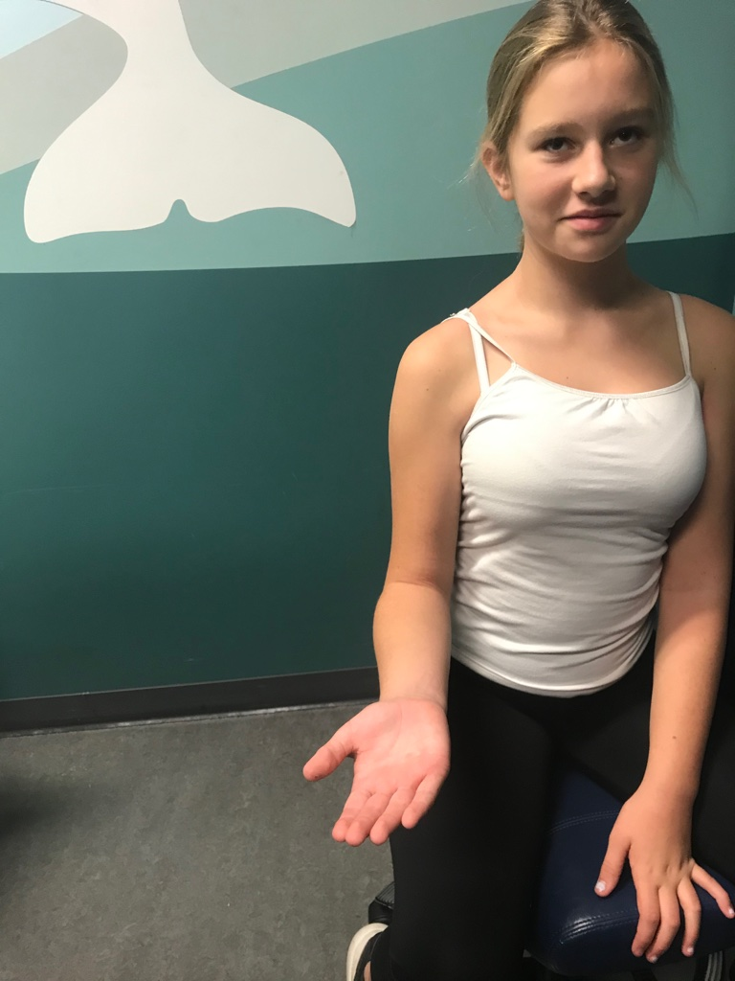
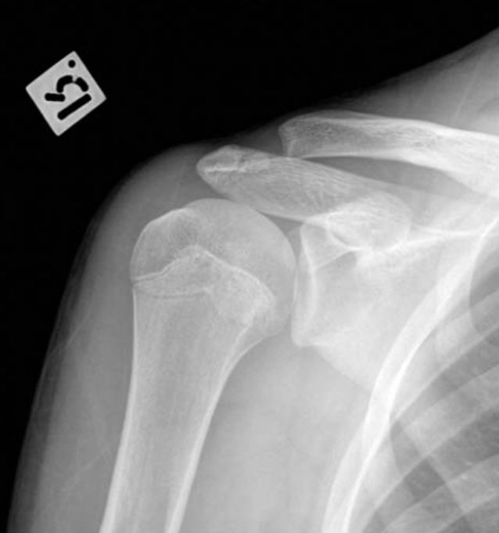
“My shoulder hurts”. The patient sits upright. The arm is neutral, the elbow flexed, the hand palm up
The LHBB runs between the GT laterally and LT anteriorly, in the bicipital groove
Neutral
AP Neutral
LHBB = long head biceps brachii, GT = greater tuberosity, LT = lesser tuberosity, G = glenoid

Slide 7
Use a high frequency linear transducer. Start anteriorly. This is the short axis of the mid LHBB.
Neutral
Short Axis LHBB
LHBB = long head biceps brachii, GT = greater tuberosity, LT = lesser tuberosity, G = glenoid

Slide 8
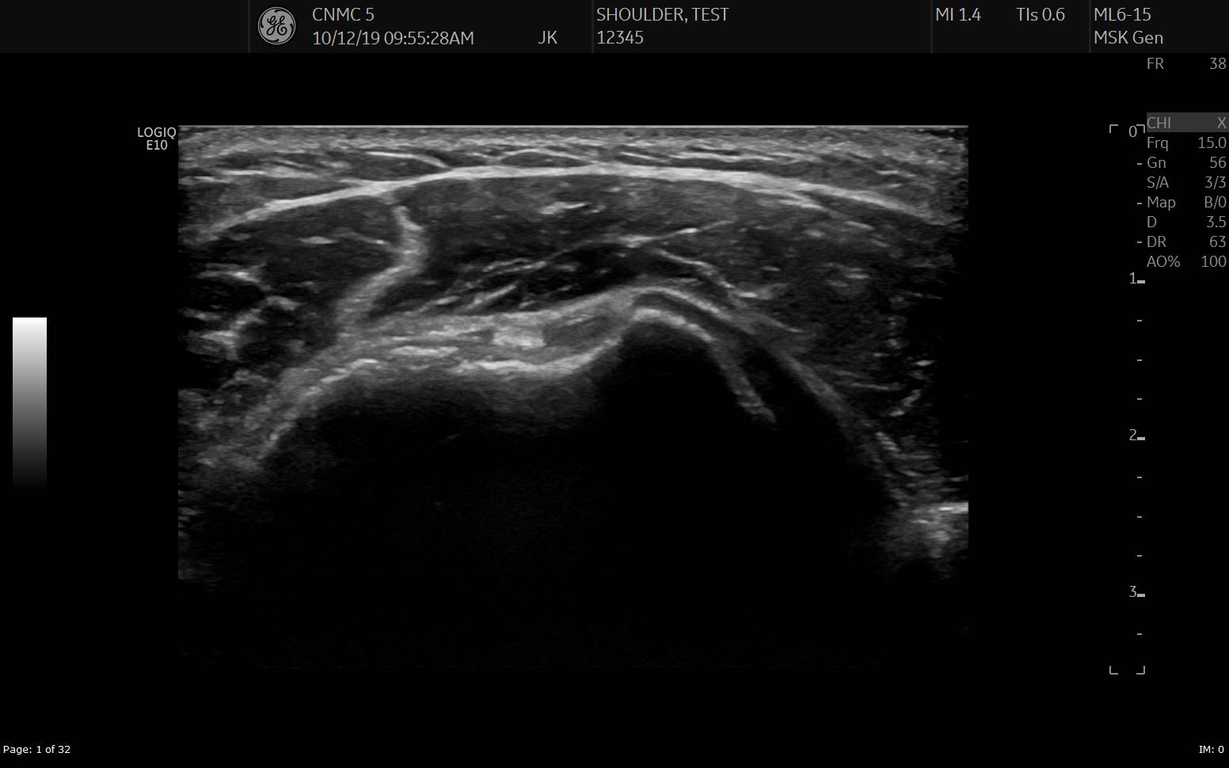
The marker is on the anatomic right. LHBB is placed centrally. It is an echogenic oval when perpendicular.
LT
GT
Neutral
Short Axis LHBB
LHBB = long head biceps brachii, GT = greater tuberosity, LT = lesser tuberosity

Slide 9
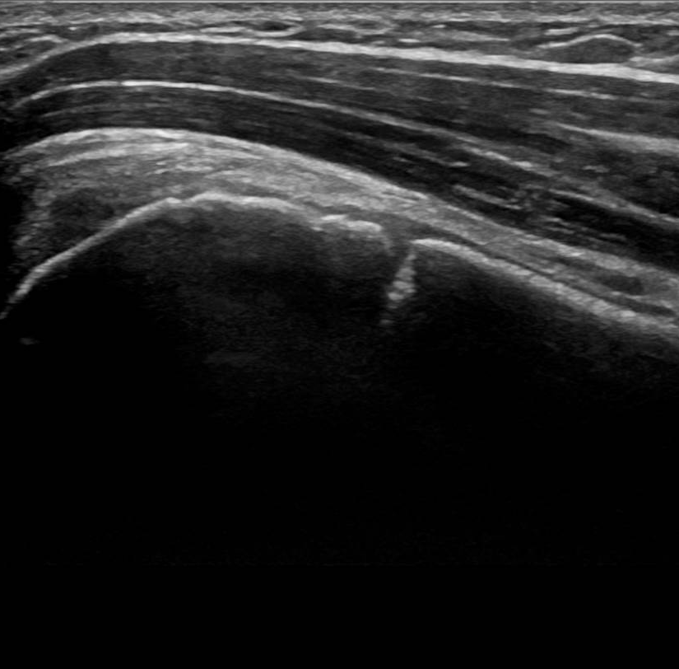
Turn the transducer 90⁰. The marker is now superior. This is the long axis.
D
LHBB
HH
GP
Neutral
Long Axis LHBB
LHBB = long head biceps brachii, GP = growth plate, HH = humeral head, D = deltoid

Slide 10
Pitfall 1: the cortical break at the physis can simulate a fracture
D
LHBB
HH
GP
Long Axis LHBB
LHBB = long head biceps brachii, GP = growth plate, HH = humeral head, D = deltoid

Slide 11
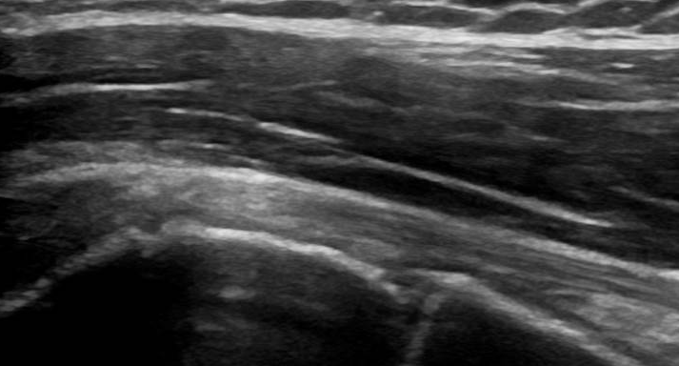
Pitfall 2: anisotrophy can simulate tendon pathology
Toggle the transducer
Angled beam becomes hypoechoic
LHBB = long head biceps brachii

Slide 12
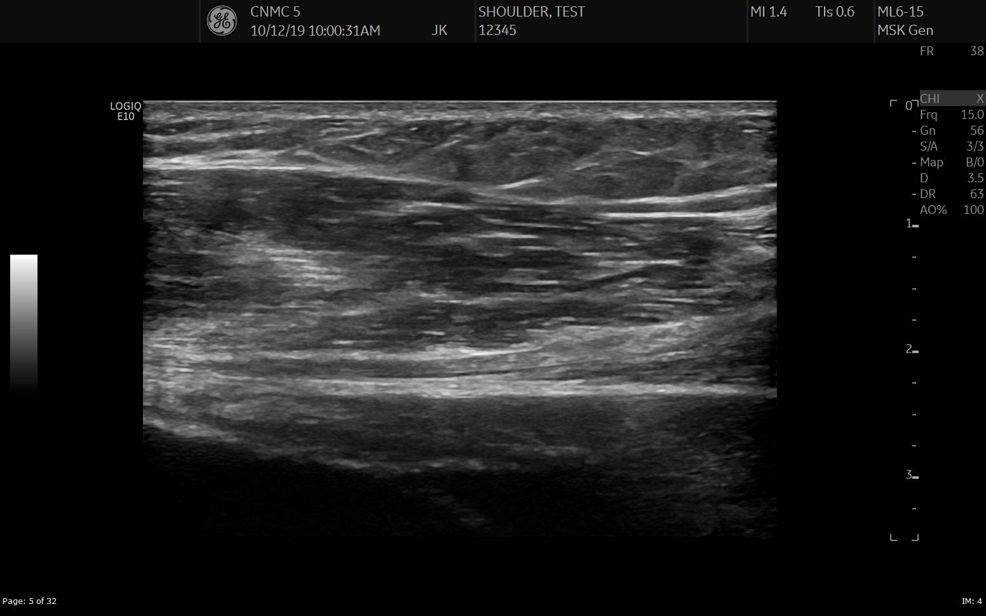
Image the distal LHBB. Slide the transducer down as far as the MTJ
D
MTJ
LHBB
Neutral
Long Axis LHBB
LHBB = long head biceps brachii, MTJ = muculotendinous junction, D = deltoid

Slide 13
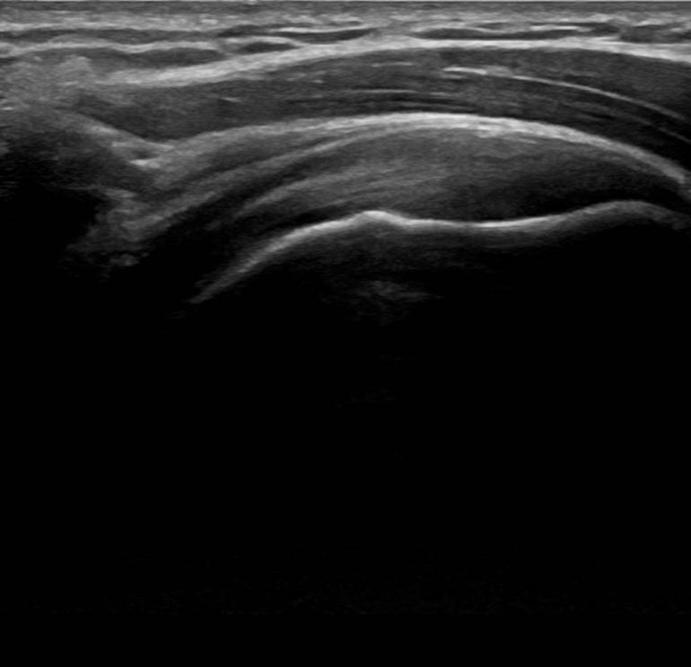
Image the proximal LHBB. Slide upwards as far as the acromion.
D
A
LHBB
Neutral
Long Axis LHBB
LHBB = long head biceps brachii, D = deltoid, A = acromion

Slide 14
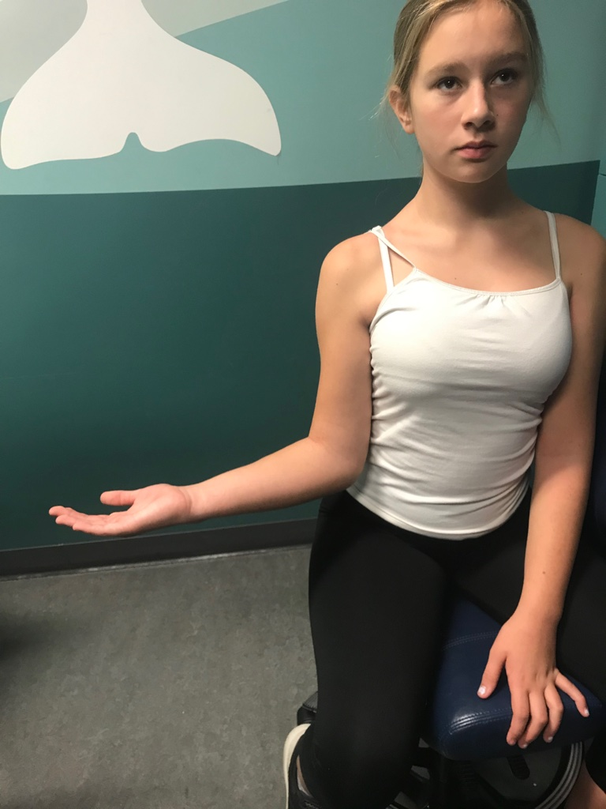
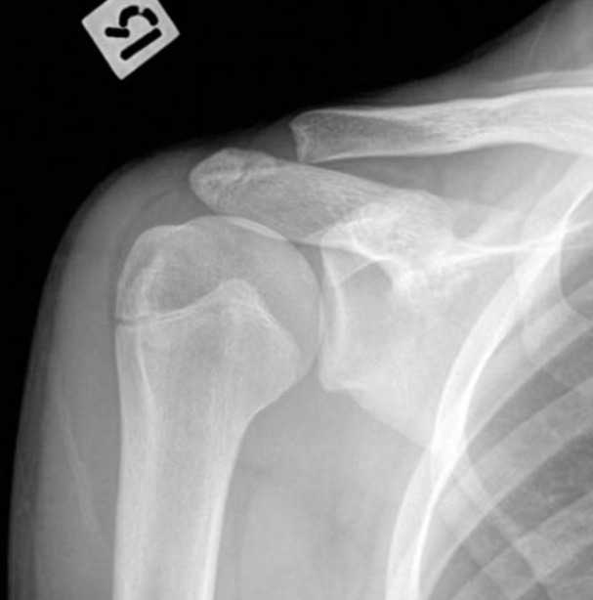
“My shoulder still hurts”. Have you evaluated all of LHBB?
External rotation exposes more of the proximal LHBB
AP External Rotation
LHBB = long head biceps brachii, GT = greater tuberosity, LT = lesser tuberosity, G = glenoid, A = acromion
Notes:
1

Slide 15
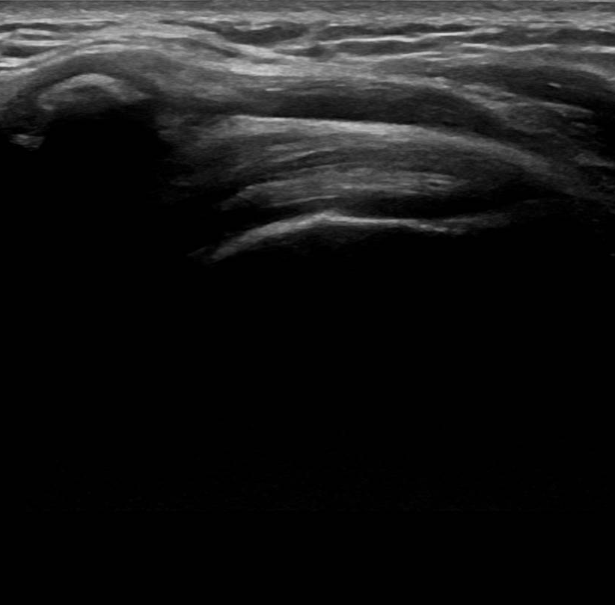
Externally rotate the arm. Image the more proximal LHBB in long axis.
A
LHBB
External Rotation
Long Axis LHBB
LHBB = long head biceps brachii, A = acromion

Slide 16
“It still hurts”. Have you evaluated all of the anterior structures?
The SUB attaches to lateral LT, and adds to the THL securing the LHBB
AP Neutral
LHBB = long head biceps brachii, GT = greater tuberosity, LT = lesser tuberosity, SUB = subscapularis, THL = transverse humeral ligament

Slide 17
Image the SUB in short axis. The transducer marker is superior. .
External Rotation
Neutral
Short Axis SUB
LHBB = long head biceps brachii, GT = greater tuberosity, LT = lesser tuberosity, COR = coracoid, SUB = subscapularis, THL = transverse humeral ligament
Notes:
In ext rotation?

Slide 18
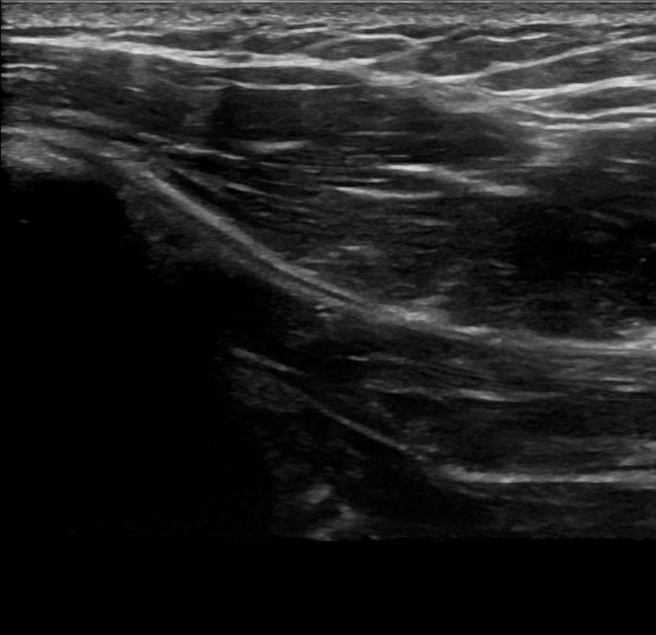
PM
Hum
SUB
External Rotation
Neutral
Short Axis SUB
Hum = humerus, PM = pectoralis major, SUB = subscapularis

Slide 19
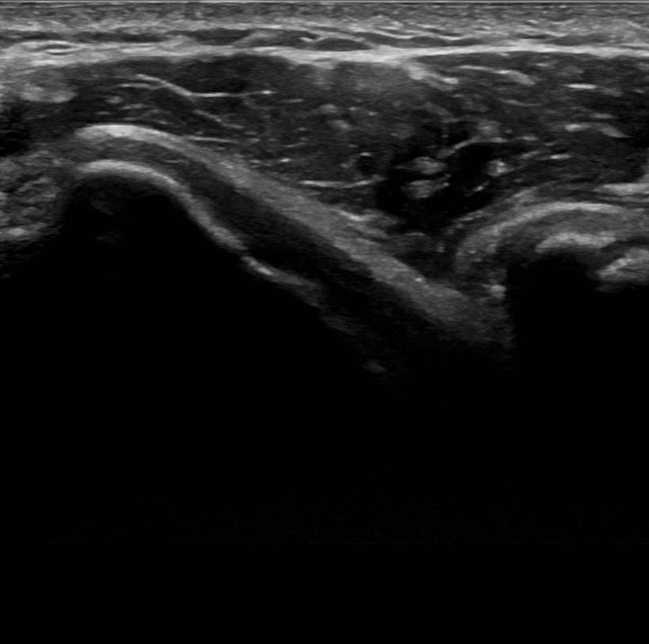
Turn the transducer 90⁰ for long axis. The marker is on the anatomic right. The COR is to the left of the image.
LT
COR
SUB
External Rotation
Neutral
Long Axis SUB
LHBB = long head biceps brachii, LT = lesser tuberosity, COR = coracoid, SUB = subscapularis, THL = transverse humeral ligament
Notes:
Coracoid to left

Slide 20
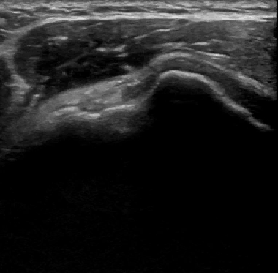
Evaluate the THL by looking for LHBB subluxation during dynamic cine.
LT
SUB
GT
Dynamic external-internal rotation
Long Axis SUB Dynamic
LHBB = long head biceps brachii, LT = lesser tuberosity, SUB = subscapularis, THL = transverse humeral ligament

Slide 21
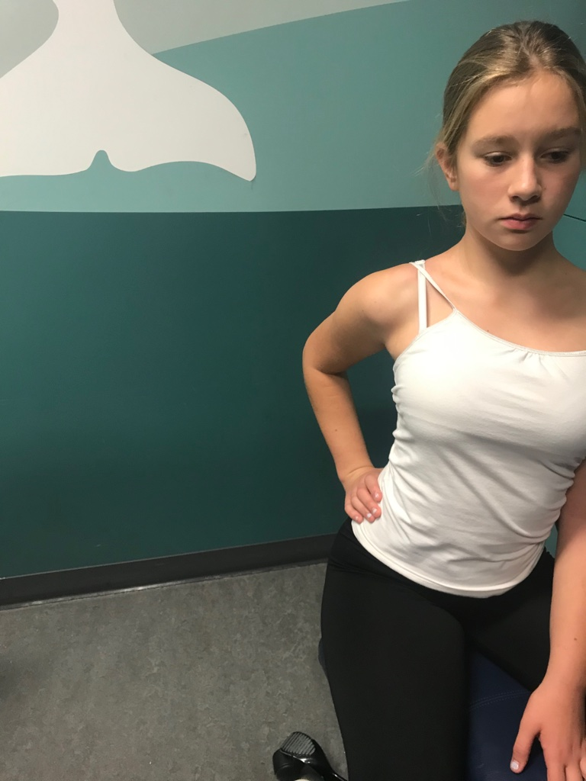
“It hurts when I raise my arm”. Rotator cuff? Less likely in a child.
The 4 muscles of the rotator cuff enclose the humeral head.
A
COR
HH
Lateral scapular
HH = humeral head, LHBB = long head biceps brachii, SS = suprascapularis, IS = infrascapularis, SUB = subcapularis, TMi = teres minor, COR = coracoid, A = acromion
Notes:
Age note

Slide 22
Ask to place hand on hip with elbow pointed backwards.
The SS, IS, & TMi insert on the horizontal, oblique, & vertical GT facets, respectively.
A
Modified Crass position
Short Axis SS
Short Axis SS
Lateral scapular
LHBB = long head biceps brachii, SS = suprascapularis, IS = infrascapularis, SUB = subcapularis, TMi = teres minor, RI = rotator interval, GT = greater tuberosity, LT = lesser tuberosity,

Slide 23
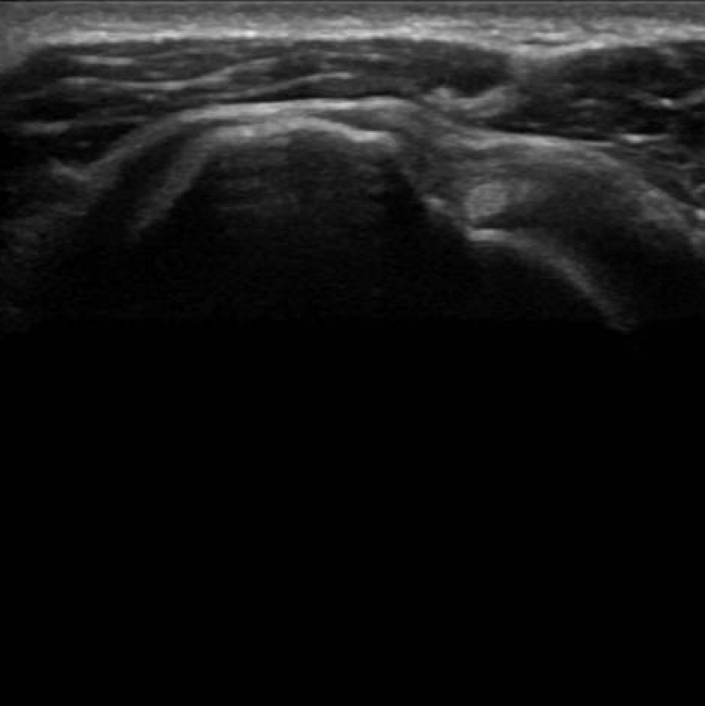
Image the SS inssertion in short axis. The RI lies between the SS and SUB and contains the LHBB
SS
HF
IS
OF
RI
SUB
Modified Crass position
Short Axis SS
LHBB = long head biceps brachii, SS = suprascapularis, IS = infrascapularis, SUB = subcapularis, HF = horizontal/superior facet, OF = oblique/middle facet, RI = rotator interval
Notes:
graphic

Slide 24
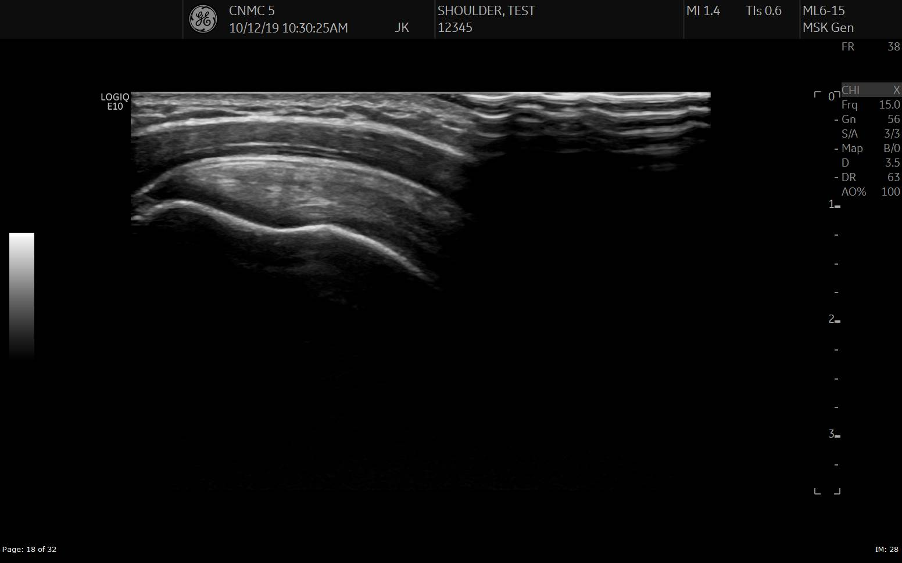
Image the SS in long axis. Toggle to counter anisotrophy.
D
SASDB
SSFP
HF
C
HH
Modified Crass position
Long Axis SS
SSFP = suprascapularis footplate, HF = horizontal/superior facet, D = deltoid, SASDB = subacromion subdeltoid bursa, HH = humeral head, C = cartilage of humeral head

Slide 25
Pitfall 3: cartilage can simulate fluid.
It looks normal. Have you
evaluated all the tendon?
D
SASDB
SSFP
HF
C
HH
Long Axis SS
SSFP = suprascapularis footplate, HF = horizontal/superior facet, D = deltoid, SASDB = subacromion subdeltoid bursa, HH = humeral head, C = cartilage of humeral head

Slide 26
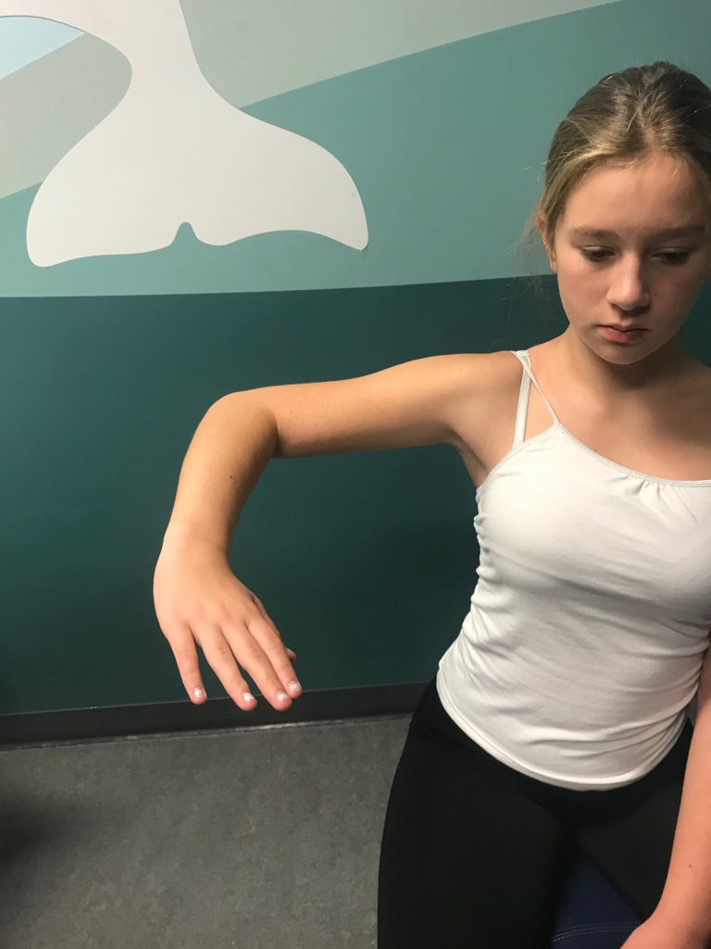
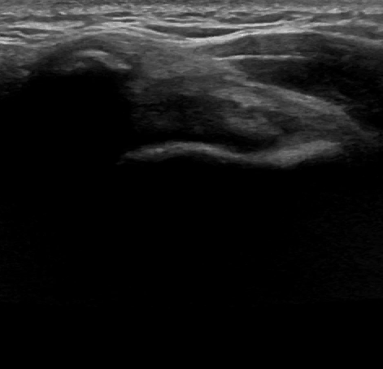
Look for sub A impingement/fluid pooling in SASDB with dynamic cine.
A
SASDB
SS
Dynamic add-abduction from neutral
Long Axis SS Dynamic
SS = suprascapularis, A = acromion, SASDB = subacromion subdeltoid bursa
Notes:
Looking for pooling of bursal fluid

Slide 27
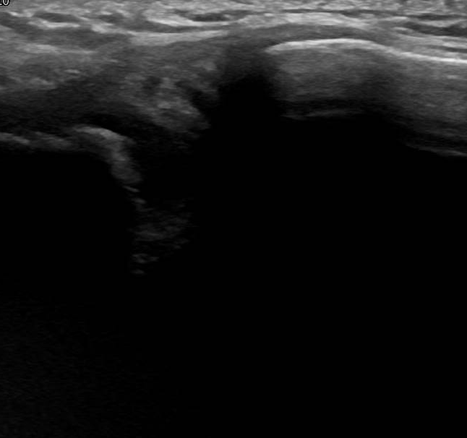
“Its also sore at the top.” Image the ACJ. Rem: cartilage can mimic fluid.
CL
A
Neutral
Long Axis ACJ
ACJ = acromioclavicular joint, A = acromion, CL = clavicle, = cartilage
Notes:
Acromial ossif centers

Slide 28
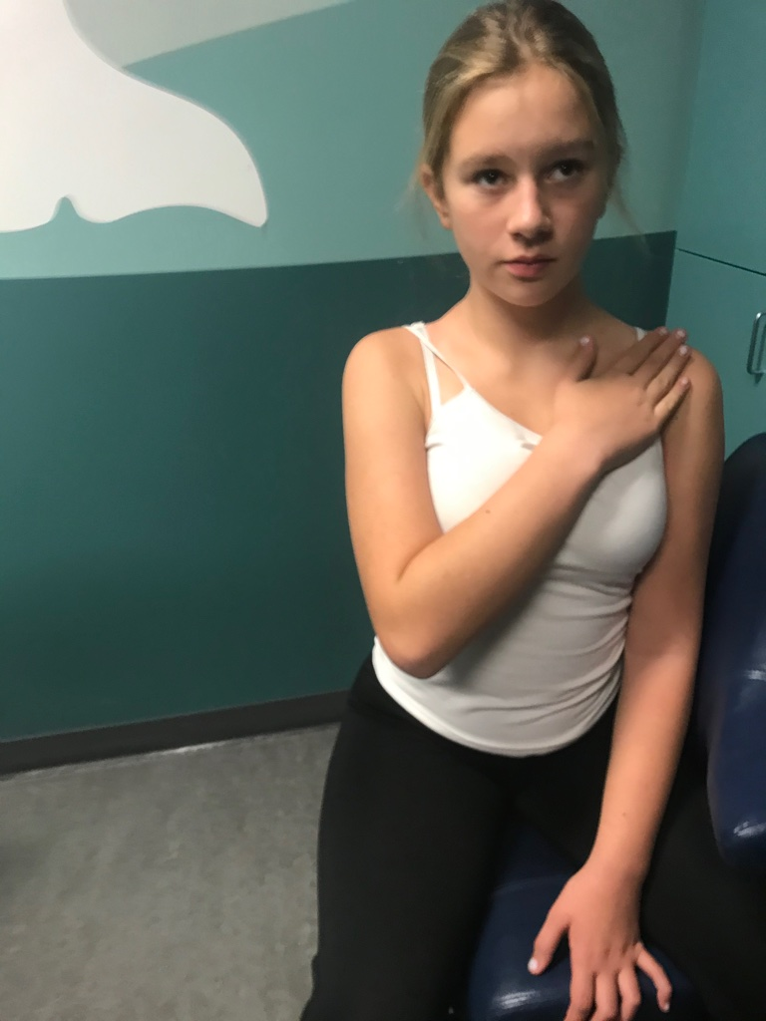
To evaluate the IS, internally rotate the arm, touching opposite shoulder
The spine of the scapula sits between SS and IS muscles
A
COR
SP
Internal rotation
Lateral Scapular
SS = suprascapularis, IS = infrascapularis, SUB = subcapularis, TMi = teres minor, COR = coracoid, A = acromion, SP = spine of the scapula

Slide 29
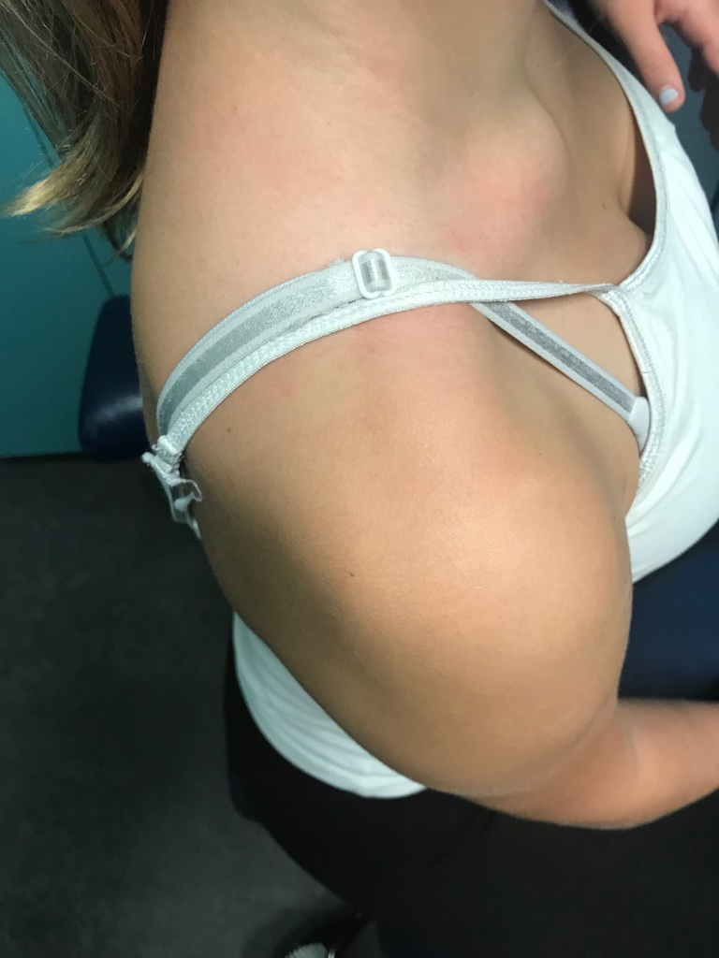
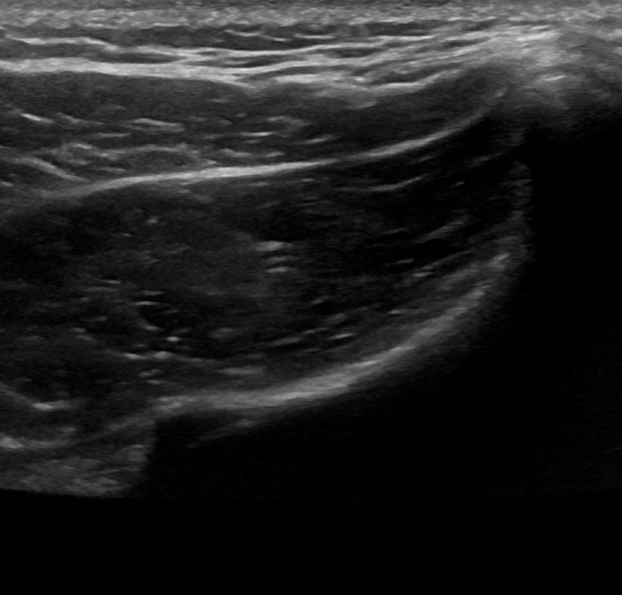
Evaluate the SS muscle in short axis. Less hyperechoic fat is seen in younger children.
T
SP
SS
Internal rotation
Short Axis SS
SS = suprascapularis, SP = spine of the scapula, T = trapezius

Slide 30
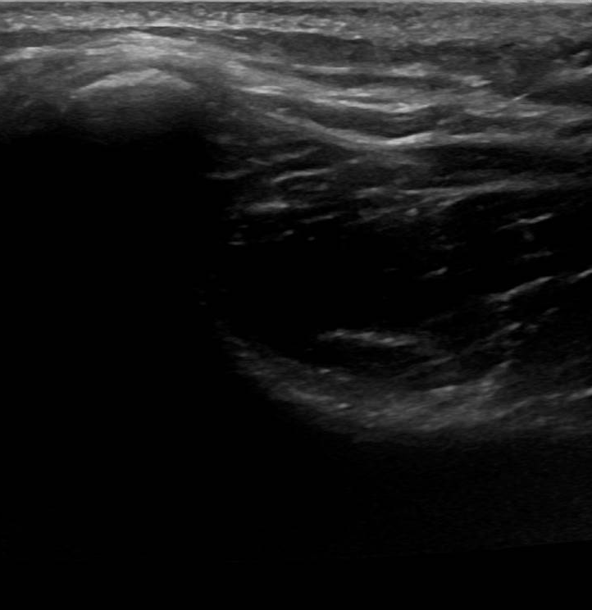
Move the transducer below the SP to evaluate the IS muscle in short axis.
T
SP
IS
Internal rotation
Short Axis IS
IS = infrascapularis, SP = spine of the scapula, T = trapezius

Slide 31
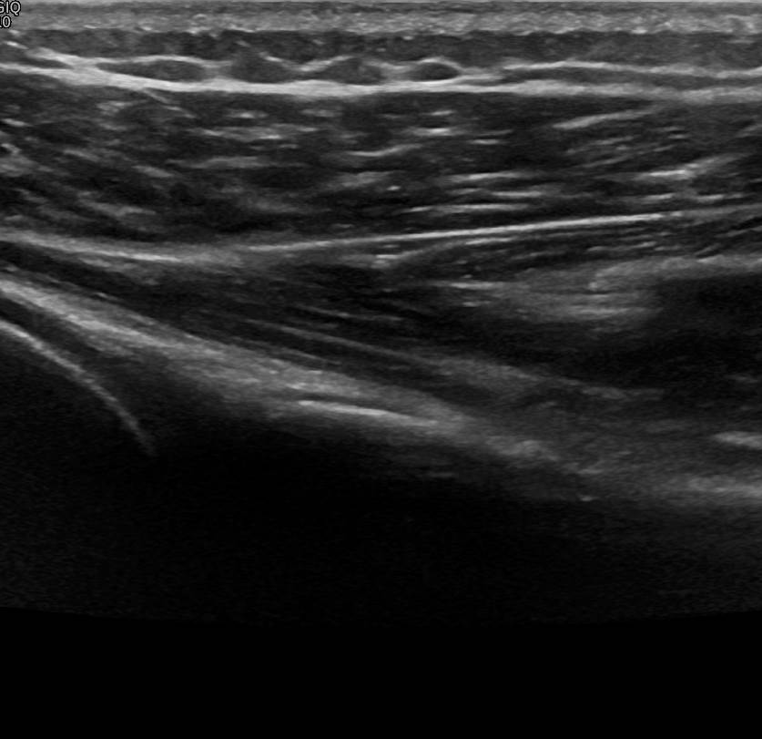
.
Turn the transducer 90⁰ to evaluate the IS tendon in long axis. Then slide the transducer down to image TMi
T
IS
Internal rotation
Long Axis IS
IS = infrascapularis, SP = spine of the scapula, T = trapezius

Slide 32
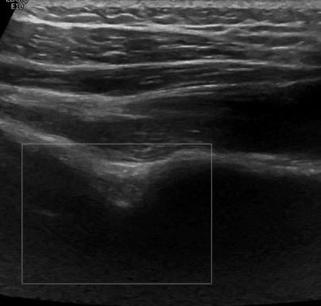
.
Slide the transducer more lateral. Color flow helps to identify the SGN, and the suprascapular vessels.
IS
SGN
G
Internal rotation
Long Axis SGN
IS = infrascapularis, G = glenoid, SGN = spinoglenoid notch

Slide 33
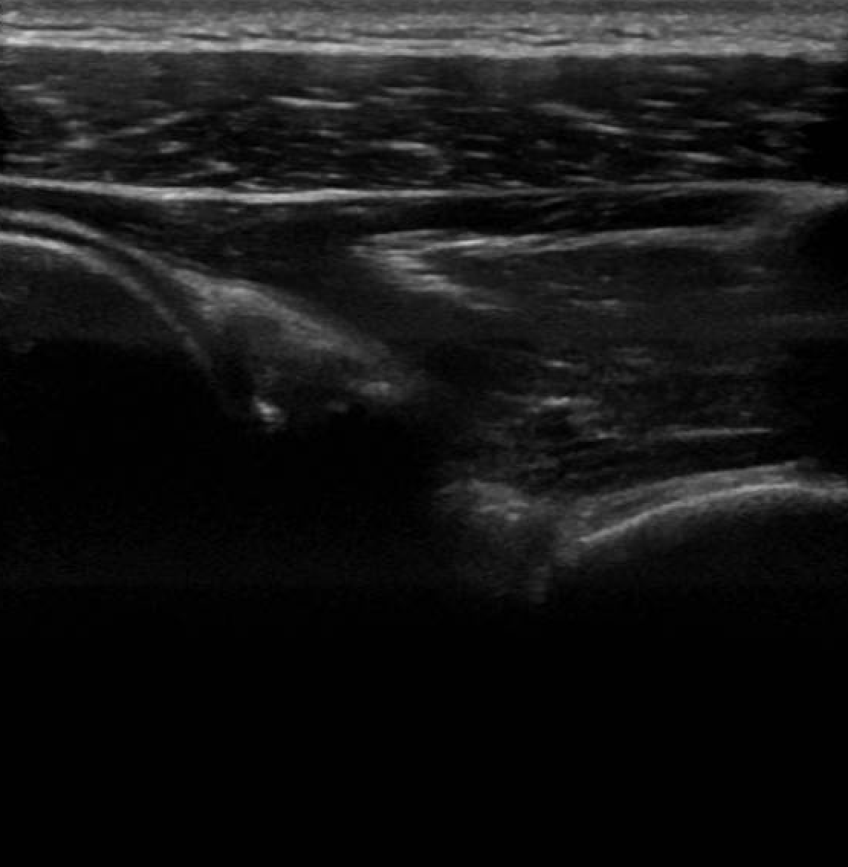
Continue to slide the transducer more lateral to evaluate the labrum. A joint effusion may be seen.
L
G
SGN
Internal rotation
Long Axis L
G = glenoid, SGN = spinoglenoid notch, L = labrum
Notes:
Pic labrum

Slide 34
Conclusions
Understanding the anatomy is key to scanning
A stepwise approach can be used for the pediatric shoulder
Recognising pitfalls can help to avoid them
Pathology differs by age and skeletal maturity

Slide 35
References
Jacobson JA. Shoulder US: anatomy, technique, and scanning pitfalls. Radiology. 2011; 260(1): 6-16.
Martinoli C et al. ESSR Musculoskeletal ultrasound: technical guidelines. Insights Imaging. 2010; 1(3): 99–141.
Moyer JE, Brey, JM. Shoulder Injuries in Pediatric Athletes. Orthop Clin N Am. 2016; 47: 749–762.
Zember J. Normal development imaging pitfalls and injuries in the pediatric shoulder. Pediatric Radiology. 2019; 49: 1617–1628 .
Harcke HT, Grissom LE. Infant shoulder sonography: technique, anatomy, and pathology. Pediatr Radiol 􏳺2001) 31: 863–868.

