Slide 1

Congenital Oral Lesions:
Spectrum of Prenatal and Postnatal Imaging
Judyta LOOMIS
^{PedIATriC RADIOLOGIST}
^{PRENATAL PEDIATRICS INSTITUTE}
^{children’s national HOSPITAL}
^{Washington, DC}
WITH Aparna Yepuri & Gilbert VEZINA

Slide 2


2019 MWHC Visiting Lecturer Series in Perinatal Pediatrics
Text In Code: 11213
Date: October 01, 2020
Speaker(s) Name: Judyta Loomis MD
Imaging and Radiology
Children's National Health System
Professor of Pediatrics and Radiology
George Washington School of Medicine
Speaker(s) Disclosure information:
‘No relevant financial relationships to report’
Talk Title: Fetal Evaluation of Congenital Oral and Neck Lesions
Learning Objectives:
Commercial Support for this activity has been provided by: No commercial support has been provided.
The following Planning Committee members have reported no relevant financial relationships:
Zacharia Cherian, MD, Mahmoud Kheirbek, MD,
Nancy Williams Horak, MD, Jacquelyn Bell Benton, RN Yolanda King, MSW
Accreditation
    In support of improving patient care, MedStar Health is jointly accredited by the Accreditation Council for Continuing Medical Education (ACCME), the Accreditation Council for Pharmacy Education (ACPE), the American Nurses Credentialing Center (ANCC) and the American Academy of Pas (AAPA) to provide continuing education for the healthcare team.
Credit Designation
    This activity was planned by and for the healthcare team, and learners will receive 1.0 Interprofessional Continuing Education (IPCE) credits for learning and change.

Slide 3
Disclosures
The author has no financial disclosures.
Disclaimers
I am pediatric radiologist with subspecialty in fetal radiology
Focus of lecture is on lesions where radiology is helpful
Excluding skin lesions, cleft lip/palate, and other facial dysmorphism

Slide 4
Objectives
Present a spectrum of congenital oral lesions
Convey key clinical and imaging pearls
Identify lesions with potential prenatal diagnosis and perinatal complications

Slide 5
Spectrum of Congenital Oral Lesions
FOREGUT
DUPLICATION
CYST
LYMPHATIC MALFORMATION
EPULIS
TERATOMA
HEMANGIOMA
DERMOID
VENOUS MALFORMATION
RHABDOMYOSARCOMA
MNTI
THE LOST THYROID

Slide 6

CLINICAL CLUES…
BLUISH | REDDISH | WATER-ish SKIN-ish | TUMOR-ish UGLY-ish
Venous Malformation | Hamangioma | Lymphatic malformation | Teratoma
MNTI | Epulis | Foregut duplication cyst | Rhabdomyosarcoma
Lymphatic malformation |  | Dermoid | MNTI

Slide 7
CLINICAL CLUES…
PRENATAL | AT BIRTH | POSTNATAL / INFANT
Epulis | Depends on size & how hard we looked | Infantile hemangioma
Teratoma |  | Rhabdomyosarcoma
Foregut duplication |  | MNTI (Melanotic Neuroectodermal Tumor of Infancy)
Congenital Hemangioma
Lymphatic Malformation

Slide 8
RADIOLOGY CLUES…
CYSTIC | SOLID | MIXED | VASCULAR
Dermoid cyst | Epulis | Teratoma | Venous Malformation
Lymphatic Malformation | MNTI | Lymphatic Malformation | Hemangioma
Foregut duplication cyst | Hamngioma |  | MNTI

Slide 9
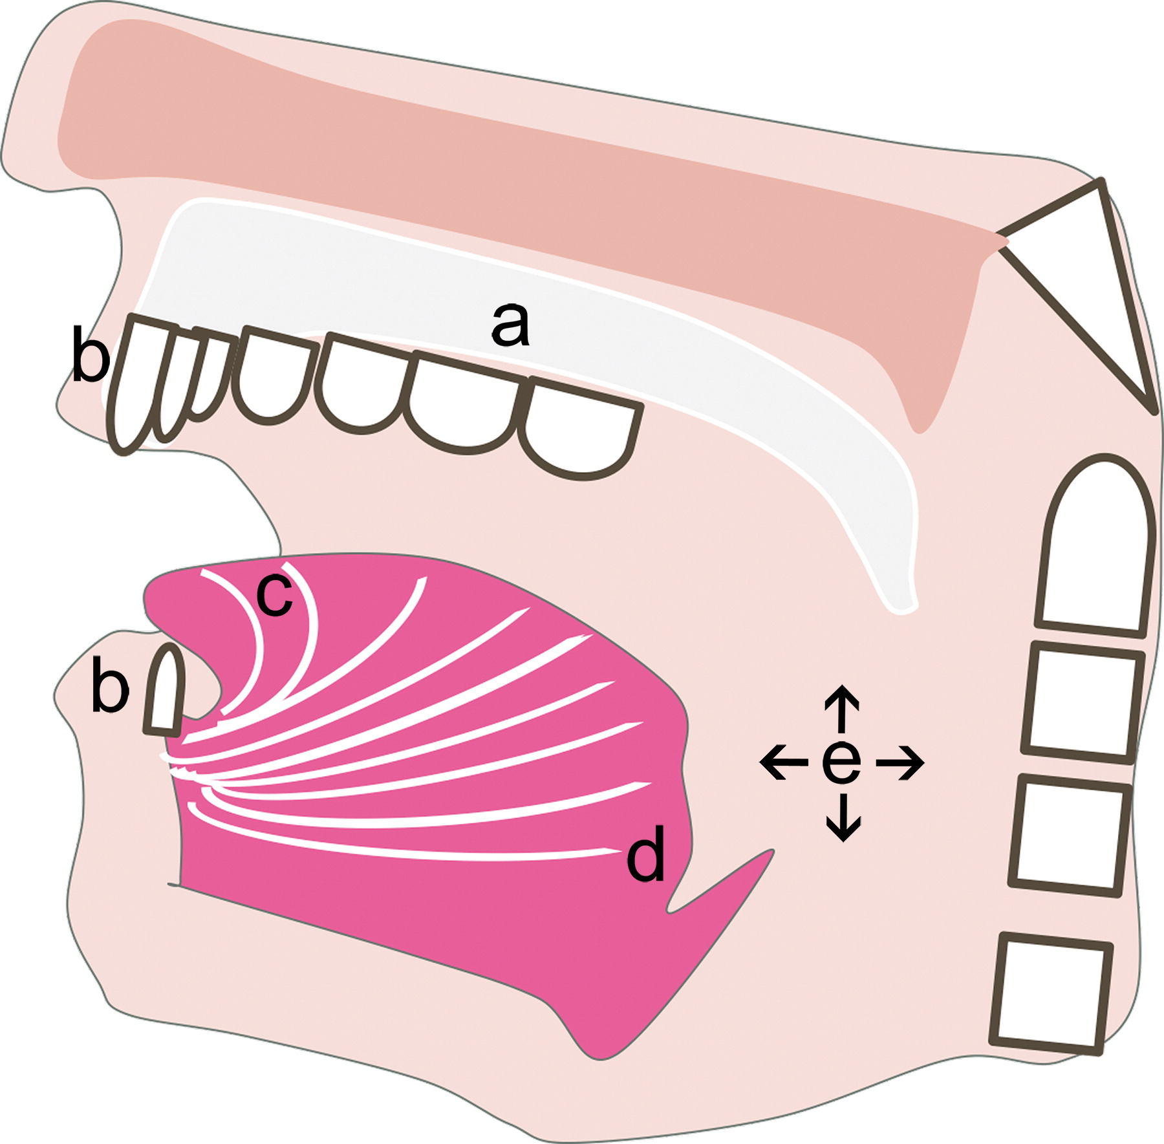

LOCATION, LOCATION, LOCATION…
Figure 2.
Midline palate - epignathus
Epulis, prenatally diagnosed, gingival
Foregut duplication cyst, centered in the anterior two-thirds of the tongue
Congenital thyroid anomaly or lingual hamartoma, posterior one-third of the tongue
Multiple head spaces suggest vascular anomalies
Chapman MC. Published Online: July 08, 2019
https://doi.org/10.1148/rg.2019180128

Slide 10
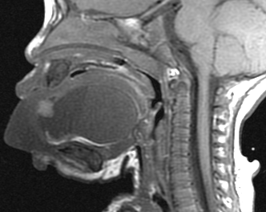
Case 1:
Clinical presentation:
8 month M with rapidly enlarging sublingual mass
Emergent overnight tracheostomy, aspirated purulent material
Initial clinical suspicion for infected lymphatic malformation
Sagittal T1: Well defined sublingual lesion with subtle fluid-fluid level (red arrow), fat component (yellow arrow), and edematous protruded tongue (blue arrow)

Slide 11
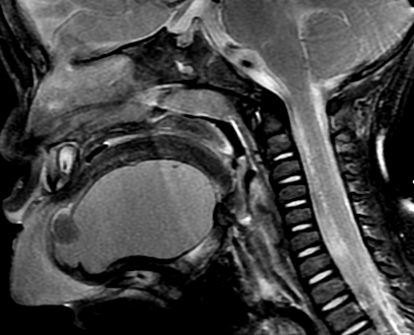
Case 1: Dermoid
Final radiologic and pathologic diagnosis: Dermoid
Basic Facts :
Sublingual midline location is the second most common of all head/ neck dermoids
Imaging :
MRI is gold standard
Intra-cystic floating fat corpuscles:
“ sack of marbles” sign
Tx: Surgical resection
Sagittal T2 fat saturated: Well defined cystic lesion in sublingual space with solid fat component (yellow arrow), and edematous protruded tongue (blue arrow)

Slide 12
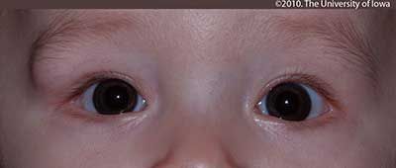
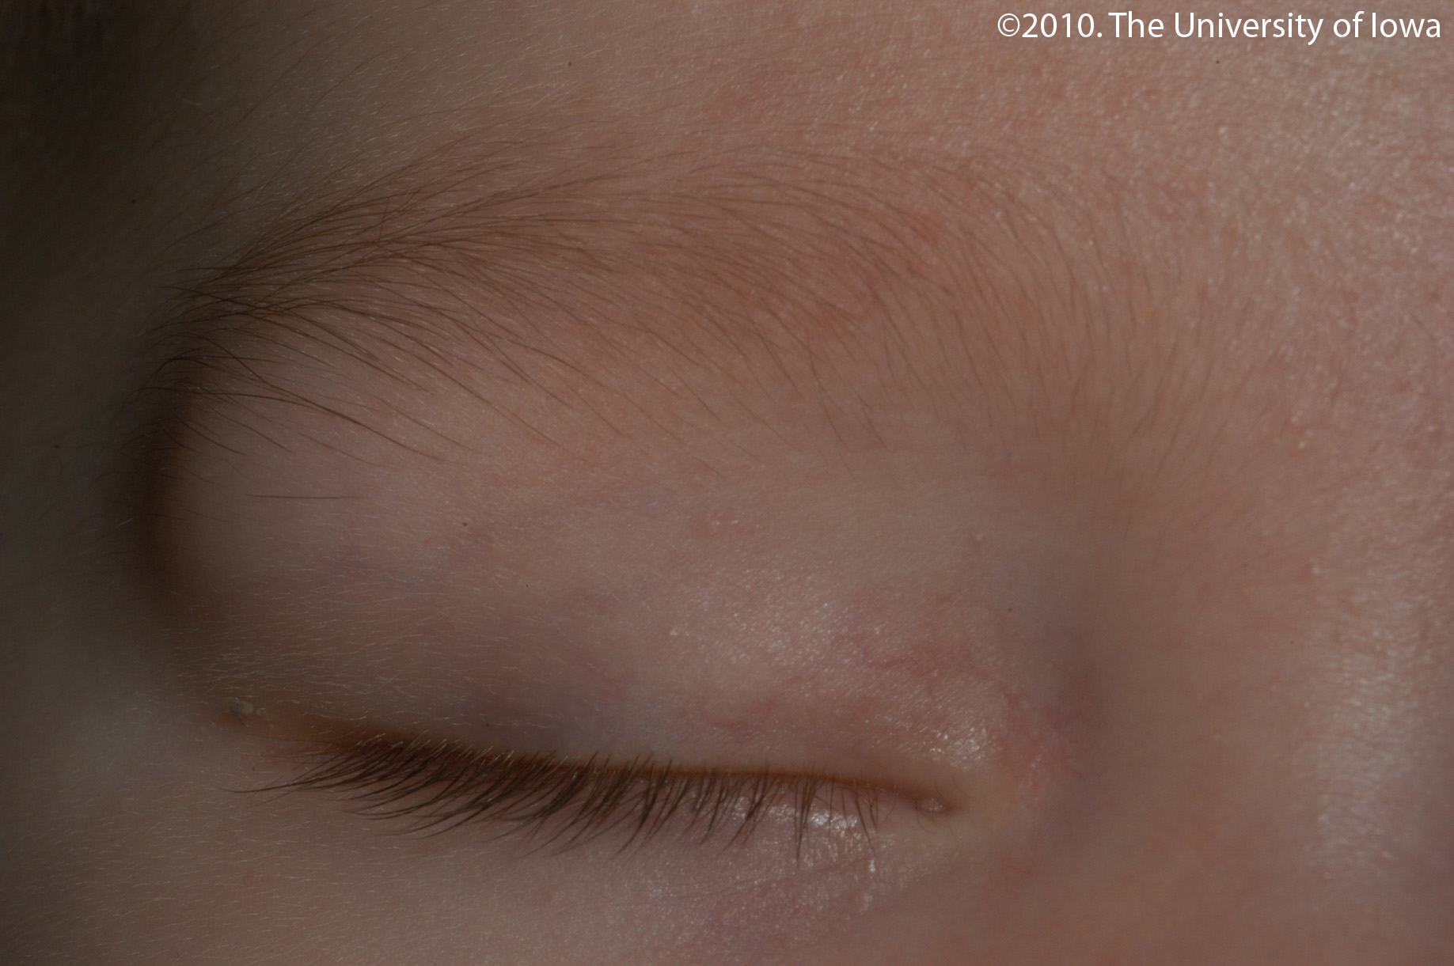
Case 1: Companion case
Most common face and neck dermoid ?
Lateral eyebrow dermoid
Clinical diagnosis, imaging only at discretion of surgeon
https://eyerounds.org/cases/115-Dermoid-Cyst.htm

Slide 13


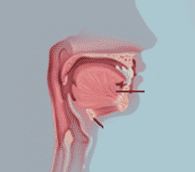



LOCATION, LOCATION, LOCATION…
DERMOID
Anterior, midline sublingual, submandibular
EPIDERMOID CYST OR RANULA
Anterior, OFF-midline, submandibular or submental space
***

Slide 14
LOCATION, LOCATION, LOCATION…
FOREGUT DUPLICATION CYST
Anterior two-thirds tongue, midline or off-midline
THYROGLOSSAL DUCT CYSTS AND ECTOPIC LINGUAL THYROID GLAND
Midline posterior one-third tongue near foramen cecum → think thyroid migrational abnormalities

Slide 15
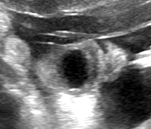
Case 2a:
Clinical presentation:
Prenatally diagnosed cystic lesion in the anterior oral cavity
AFI 10 at 21 weeks, AFI 13.5 at 32 weeks GA
Advanced airway present in delivery room
Transferred to Children’s Hospital on DOL 0
Surgical intervention on DOL 5
Prenatal 21 weeks gestation age US: Coronal image of the fetal face with fetal nose (yellow arrow) fetal lips (blue arrow), and anechoic lesion (red arrow) protruding from the anterior oral cavity

Slide 16
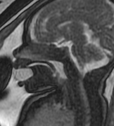
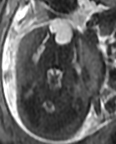
Case 2a: Foregut Duplication Cyst
Prenatal MRI at 33 weeks gestational age: Sagittal and axial T2 images demonstrate well demarcated T2 hyperintense lesion (red arrows) in a bi-lobed configuration, protruding from the oral cavity

Slide 17
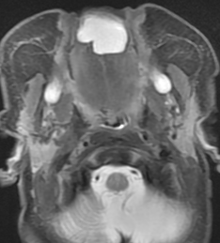
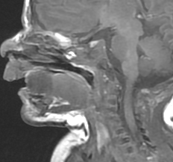
Case 2a: Foregut Duplication Cyst – Case A
Basic facts :
Lingual location of foregut duplication cysts is rare - only 0.3% arise from the tongue
May be lined with tissue from various components of the foregut
Does not communicate with the gastrointestinal lumen
Imaging Features:
Usually have the appearance of simple fluid
Postnatal DOL 3, Sagittal T1: T1 hypointense anterior tongue mass (red arrow).
Postnatal DOL 3, axial T2 FS: Cystic lesion at the anterior tongue (red arrow)

Slide 18
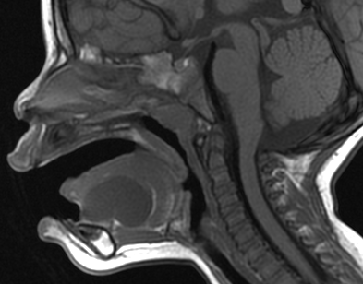
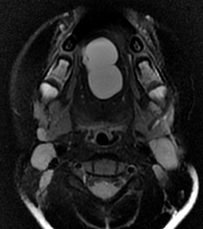
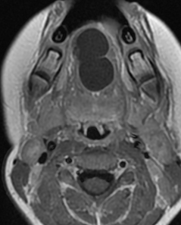
Case 2b: Foregut Duplication Cyst
Different Patient : Presenting at 17 months with sublingual lesion
Sagittal T1
Axial T2 Fat sat
Axial T1 post contrast
T1 hypointense , T2 hyperintense , non enhancing cystic lesion in the sublingual region (red arrow).

Slide 19
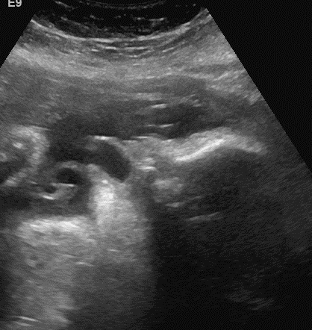
Case 2: Foregut Duplication Cysts
Tx: Surgical resection, postnatal MR face with contrast
Sagittal T1 postnatal
Sagittal US at 32 weeks
Axial T2 postnatal

Slide 20
I forgot… What is the foregut?
anterior part of the alimentary canal
From mouth to duodenum at the entrance of the bile duct
FOREGUT DUPLICATION CYSTS, FOREGUT MALFORMATIONS
Bronchogenic cyst ( anomalous budding of tracheobronchial tree)
Enteric cysts: lingual, esophageal, gastric
Neurenteric cysts ( rare, associated with the spinal canal)

Slide 21
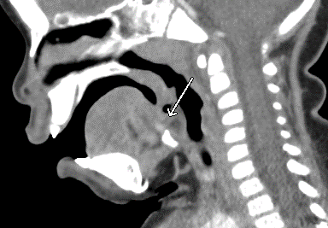
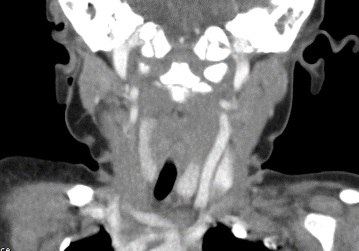
Case 3a: Ectopic thyroid tissue:
Radiologists see this more than clinicians
Clinical Presentation: Often incidental as in this 15 month old with neck swelling, CT to r/o RPA
Sagittal CT demonstrates small hyperdense focus at the base of the tongue
Coronal CT image with asymmetric elongated right thyroid lobe

Slide 22
Case 3b:
Clinical Presentation: 10 m/o male with rapidly progressing submandibular
and submental swelling concerning for Ludwig's angina
Imaging :
Abscess in deep submental space with surrounding cellulitis
Considerations include infectedvallecular cyst,
thyroglossal duct cyst,
less likely to be a dermoid
Normal thyroid present
Axial CT neck shows complex fluid collection in submental space and normal thyroid tissue (pink arrow)
Sagittal CT neck shows location inferior to the base of the tongue ( green arrow) without mass effect on airway

Slide 23
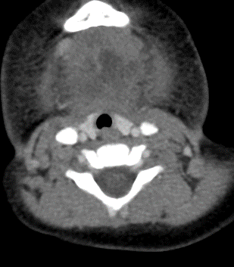
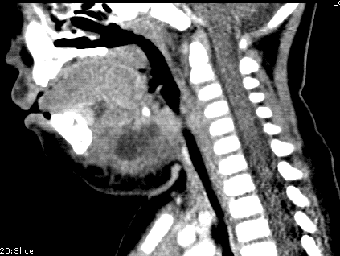
Case 3b: Infected thyroglossal duct cyst
Clinical Presentation: 10 m/o male with rapidly progressing submandibular
and submental swelling concerning for Ludwig's angina
Imaging :
Abscess in deep submental space with surrounding cellulitis
Considerations include infected vallecular cyst,
thyroglossal duct cyst,
less likely to be a dermoid
Normal thyroid present
Axial CT neck shows complex fluid collection in submental space and normal thyroid tissue (pink arrow)
Sagittal CT neck shows location inferior to the base of the tongue ( green arrow) without mass effect on airway

Slide 24
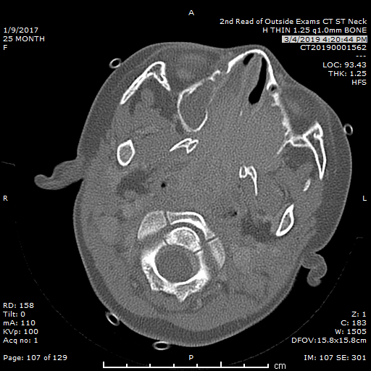
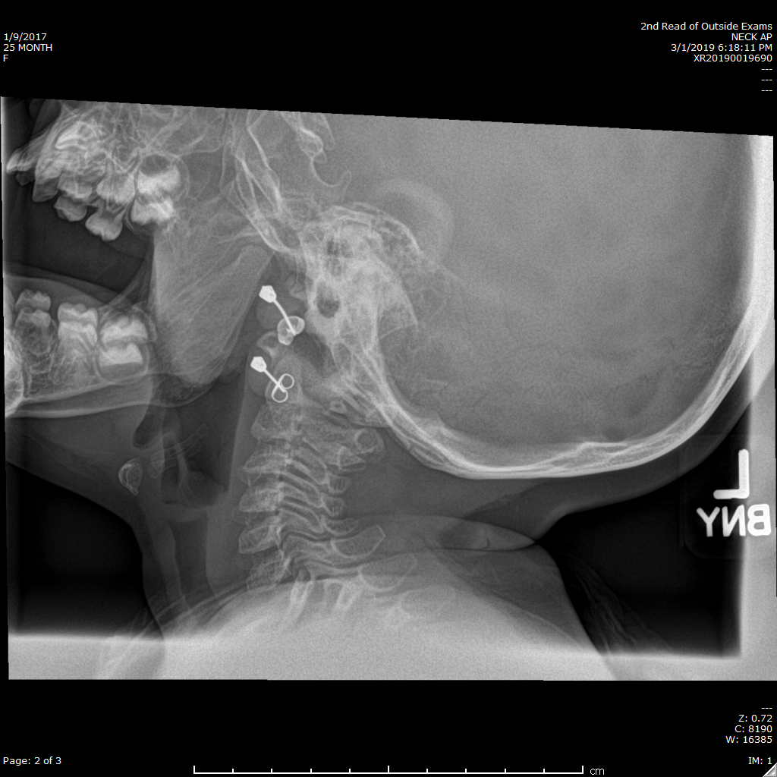
Case 4: Rhabdomyosarcoma
Clinical presentation: 25 month old with enlarging nasopharyngeal mass
Basic facts:
slight male predilection
(M:F 1.67:1)
- Rare in infants
Distribution
head and neck: ~50%
genito-urinary: ~25%
extremities: ~15%
other: ~10%
Lateral airway radiograph: soft tissue
density lesion in oropharynx (red arrow).
Axial CT, bone window: Aggressive, infiltrative mass centered in the nasopharynx with osseous destruction (red arrow).

Slide 25
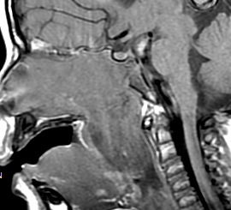
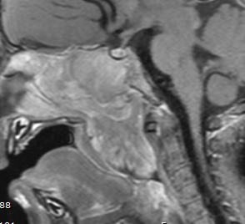
Case 4: Rhabdomyosarcoma
Sagittal T1 Pre and post contrast images: T1 isointense to hypointense lesion involving the nasal cavity, nasopharynx and oropharynx with intense post contrast enhancement (red arrow)

Slide 26
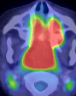
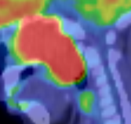
Case 4: Rhabdomyosarcoma
Imaging Features :
Soft tissue mass with ill- defined borders, adjacent bony destruction, and can be necrotic at presentation
Intense enhancement with contrast administration
FDG PET avidly positive in primary lesions and metastases
Axial and Sagittal PET CT images: Intense radiotracer uptake in the oropharyngeal tumor (red arrow).

Slide 27
Case 4: Rhabdomyosarcoma
PRENATAL:
very rare to be congenital, rare in infancy
POSTNATAL IMAGING
CT for bony destruction
MR for extent of tumor to vessels, nerves
PET CT
Tx: Curative resection if possible, chemotherapy
Lateral airway radiograph: soft tissue
density lesion in oropharynx (red arrow).

Slide 28
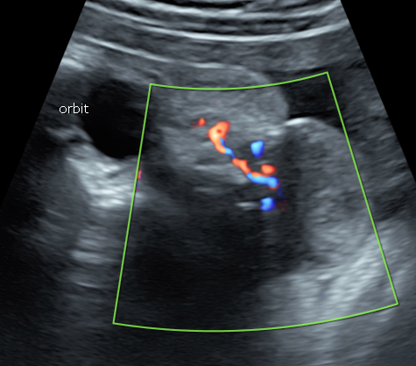
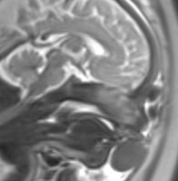
Case 5:
Clinical Presentation: 36 week prenatal US with ovoid solid lesion protruding from anterior mouth
Prenatal MRI, Sagittal T2: T2 hypointense mass (yellow arrow), arising from upper lip region.
Coronal Fetal US: Exophytic, rounded solid mass ( yellow arrow) with vascular pedicle (red arrow)

Slide 29
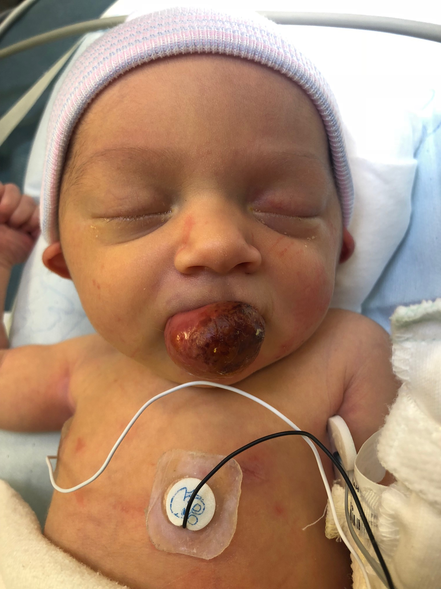

Slide 30
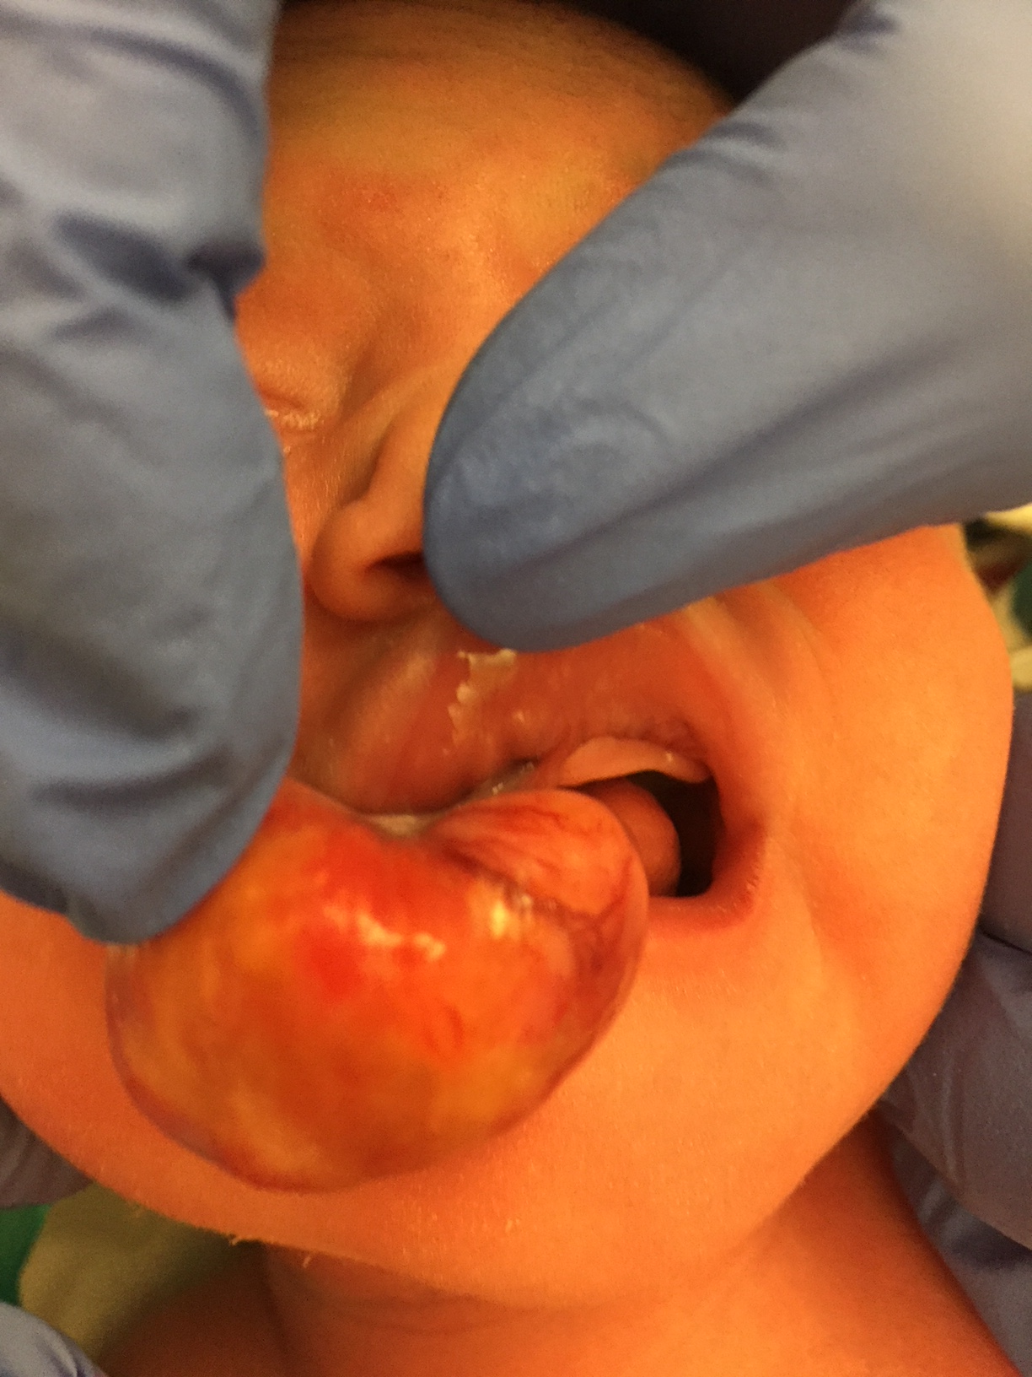
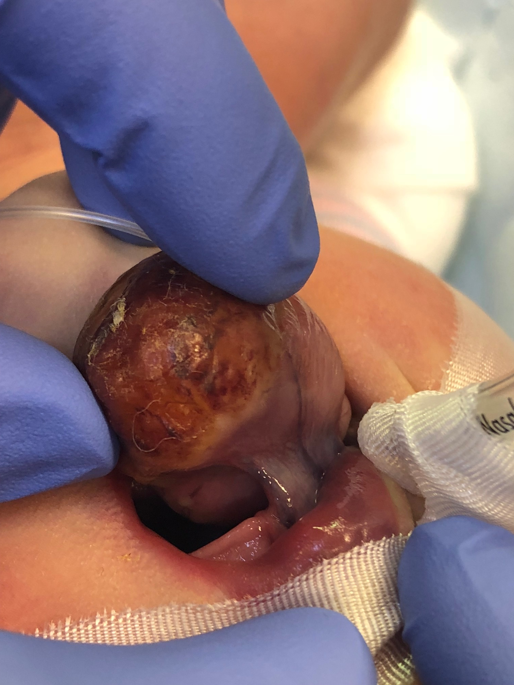

Slide 31
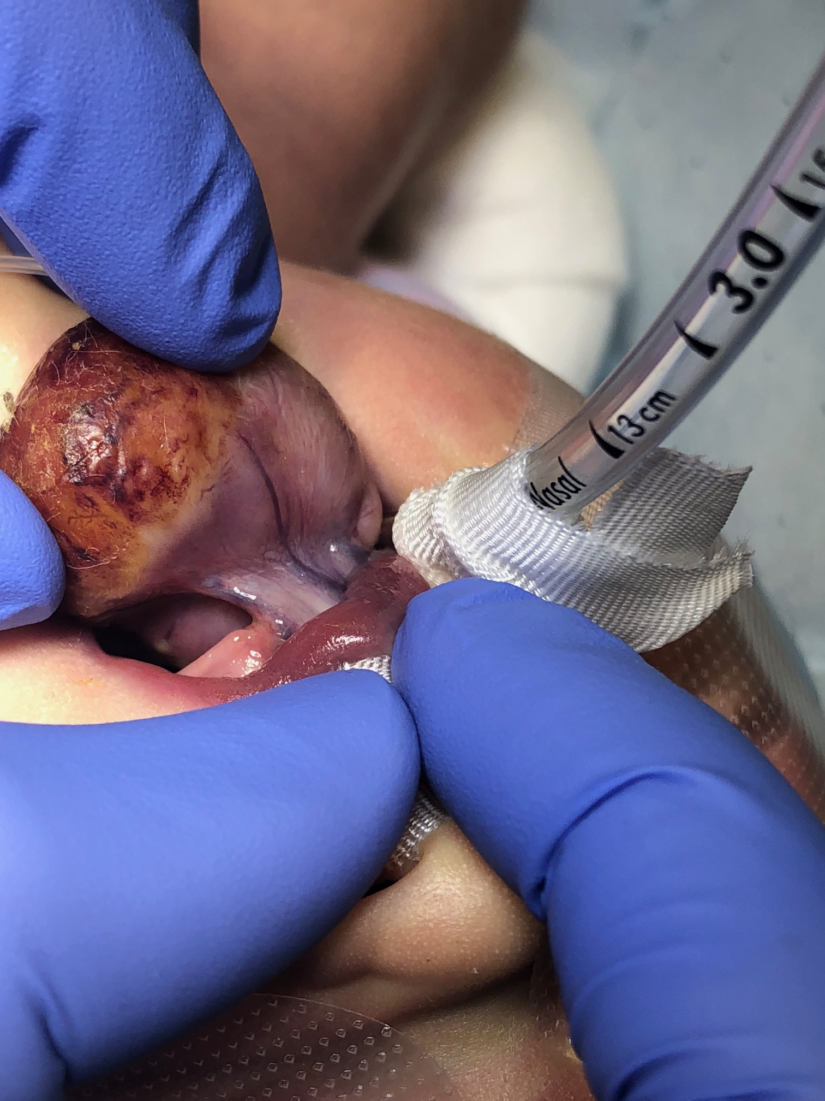

Slide 32
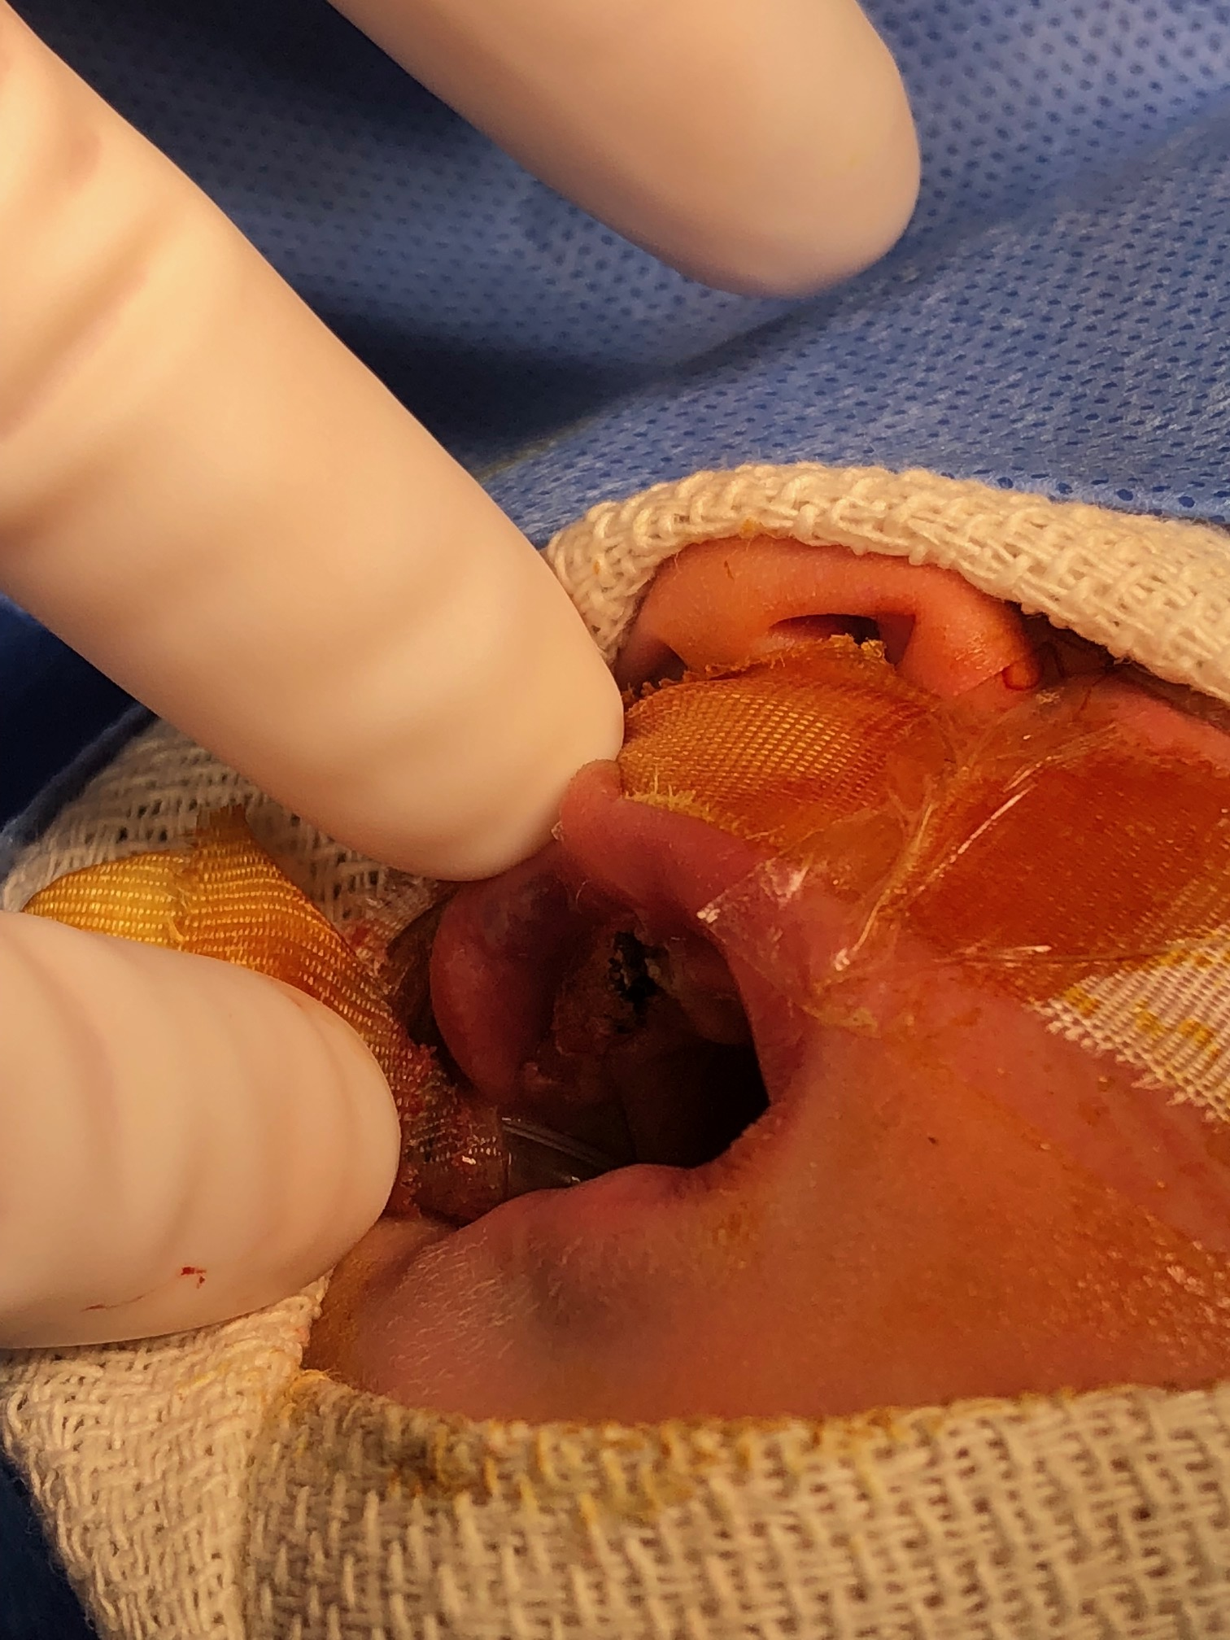
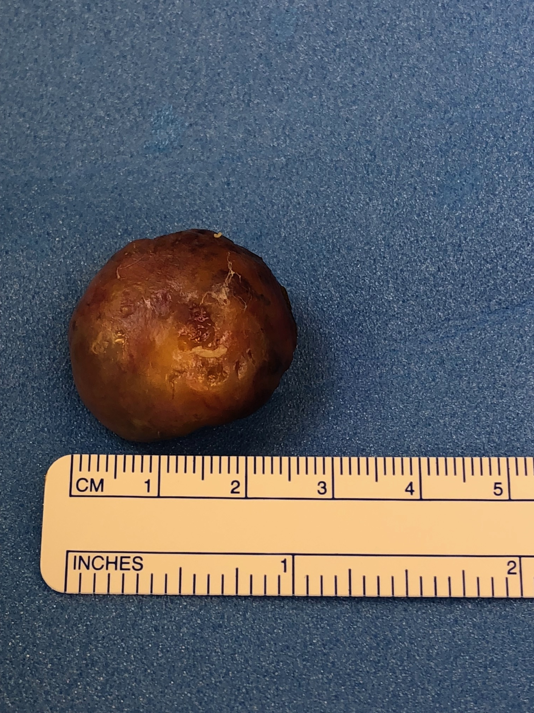

Slide 33
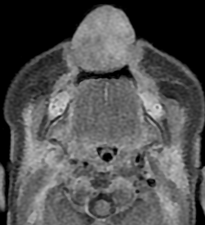
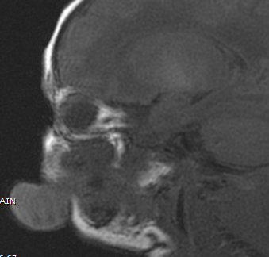
Case 5: Epulis – Granular Cell Tumor
Clinical Presentation continued: 1 day old with a solid lesion protruding from the anterior border of the mouth, similar to fetal imaging
Basic facts :
Uncommon
Benign soft tissue lesion arises typically from the alveolar mucosa
More common in females, 8-10x
Imaging Features :
MRI: Well defined solid mass lesion with vascular pedicle
Intense post-contrast enhancement
Sagittal T1: Isointense lesion arising from maxillary alveolar ridge(red arrow).
Axial T1 post contrast: Homogenously enhancing lesion (yellow arrow).

Slide 34
Case 5: Epulis
Epulis or congenital granular cell tumor
  AKA: Neumann tumor, granular cell rhabdomyoma, and congenital myoblastoma
gingival mucosa or alveolar ridge of the maxilla, less common mandibular lesions
Vascular, can bleed
Usually NOT an airway issue
  continue to monitor AFI, stomach fluid

Slide 35
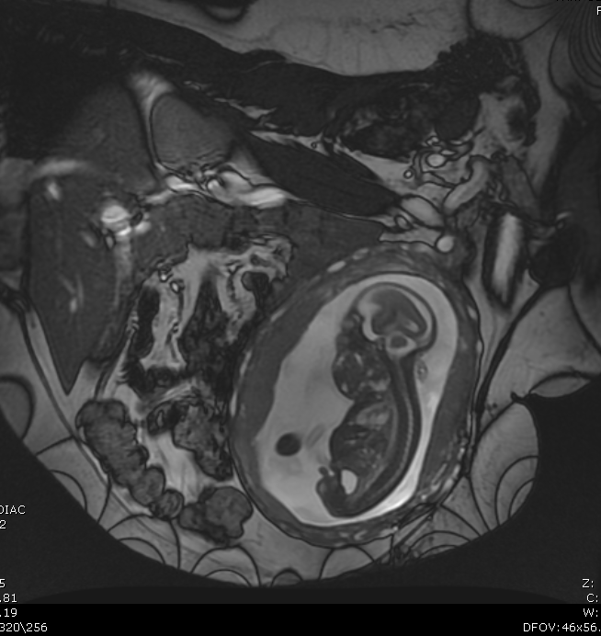
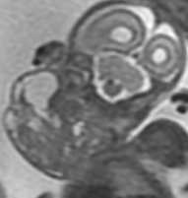
Case 6: Teratoma
Clinical Presentation: 22 week fetus with a large neck mass occupying the oral cavity.
Sagittal US image: mixed solid cystic mass
Sagittal, and Coronal T2: mixed solid and cystic left neck mass extending to involve the oral cavity.

Slide 36
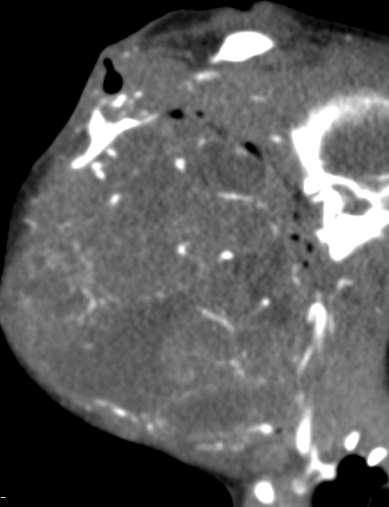
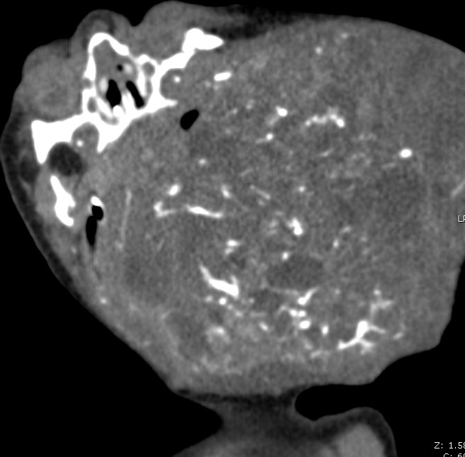
Case 6: Teratoma
Clinical Presentation: 1 day old male with prenatal diagnosis of large neck mass occupying the oral cavity.
Basic facts :
~ 3% of all childhood teratomas occur in the face/neck
EPIGNATHUS is a term for a teratoma arising from the hard or soft palate
High morbidity & mortality
More common in females
Malignant transformation
rare, but unable to resect
Axial and Sagittal CT : Heterogeneously enhancing mass compressing airway (red arrow).

Slide 37
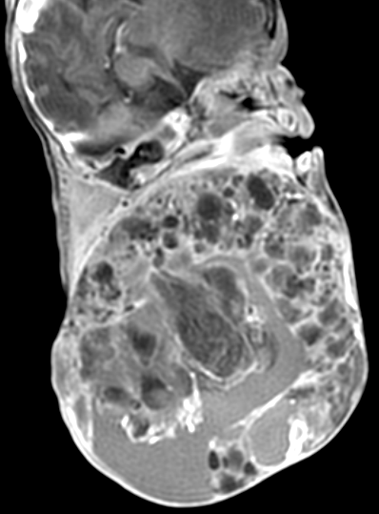
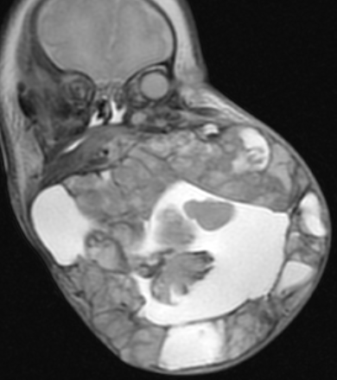
Case 6: Teratoma
Clinical Presentation: 6 DOL M with prenatal diagnosis of large neck mass occupying the oral cavity.
Imaging :
MRI & US helpful for characterization of lesion location, airway assessment, intracranial extension
Prenatally imaging to assess for hydrops, polyhydramnios, lesion growth or hemorrhage
Sagittal Post contrast T1: Heterogeneously enhancing mass compressing airway
Coronal T2: Mixed solid cystic lesion centered in the oral cavity.

Slide 38
Case 6: Teratoma
Tx: Palliative or curative resection
Prenatal Dx and Monitoring:
AFI for polyhydramnios
Stomach fluid present?
Hydrops risk
Lesion hemorrhage
MRI & US helpful for characterization of lesion location, airway assessment, intracranial extension

Slide 39
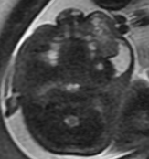
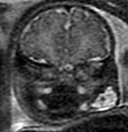
Case 7: Lymphatic Malformation
Clinical Presentation: 36 week fetus with left facial lesion.
Basic Facts :
Relatively common soft tissue lesion, occurring in 1/2000-4000 live births
Present in many areas of the body
Benign but approximately 50% may increase in size during pregnancy
Axial and Coronal T2 : T2 hyperintense lesion along the left cheek extending into the upper lip with macrocysts (red arrow) and some solid-appearing (microcystic, yellow arrow) components

Slide 40
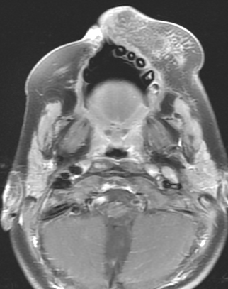
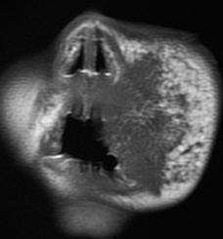
Case 7: Lymphatic Malformation
Clinical Presentation: 24 month old with left facial lesion.
Imaging:
Prenatal MRI & US helpful for characterization of location, if near airway
Very large lesions can displace or narrow airway, impede swallowing
Coronal T1 and Axial T1 post contrast : Mixed cystic and pseudo-solid (microcystic) mass along the left cheek extending into the upper lip with heterogeneous post contrast enhancement

Slide 41
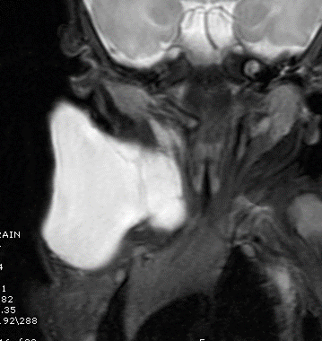
Case 7: Lymphatic Malformation
FACE NECK
FACE
More likely microcystic or pseudo-solid
Prenatal misdiagnosis of solid mass or macroglossia
NECK:
Often accurate prenatal dx
Large transpatial macrocystic lesions
Can bleed and enlarge perinatally
Potential of airway compression, but rare
Axial T2 Fetal face shows macrocystic and microcystic components of LM
Coronal T2 of different DOL 2 patient demonstrates a macrocystic exophytic trans-spatial LM

Slide 42
Case 8: Venous Malformation
Clinical Presentation: 74 day old with right facial and tongue lesion
Basic Facts:
Most common “true” vascular malformation of face
Slow flow with an abnormal venous network .
Axial and Coronal T2 W images – Hyperintense lesion of the tongue and right face .

Slide 43
Case 8: Venous Malformation
Basic Facts:
Composed of small and large dysplastic, postcapillary, thin-walled vascular channels with sparse smooth muscle and variable amounts of hamartomatous stroma, thrombi, and possible phleboliths
Imaging:
T1 hypointense, T2 hyperintense lesions with internal septations.
Intense late venous / delayed enhancement
No enlarged arteries
Axial post contrast T1 : Enhancing lesion of the tongue and right face .

Slide 44
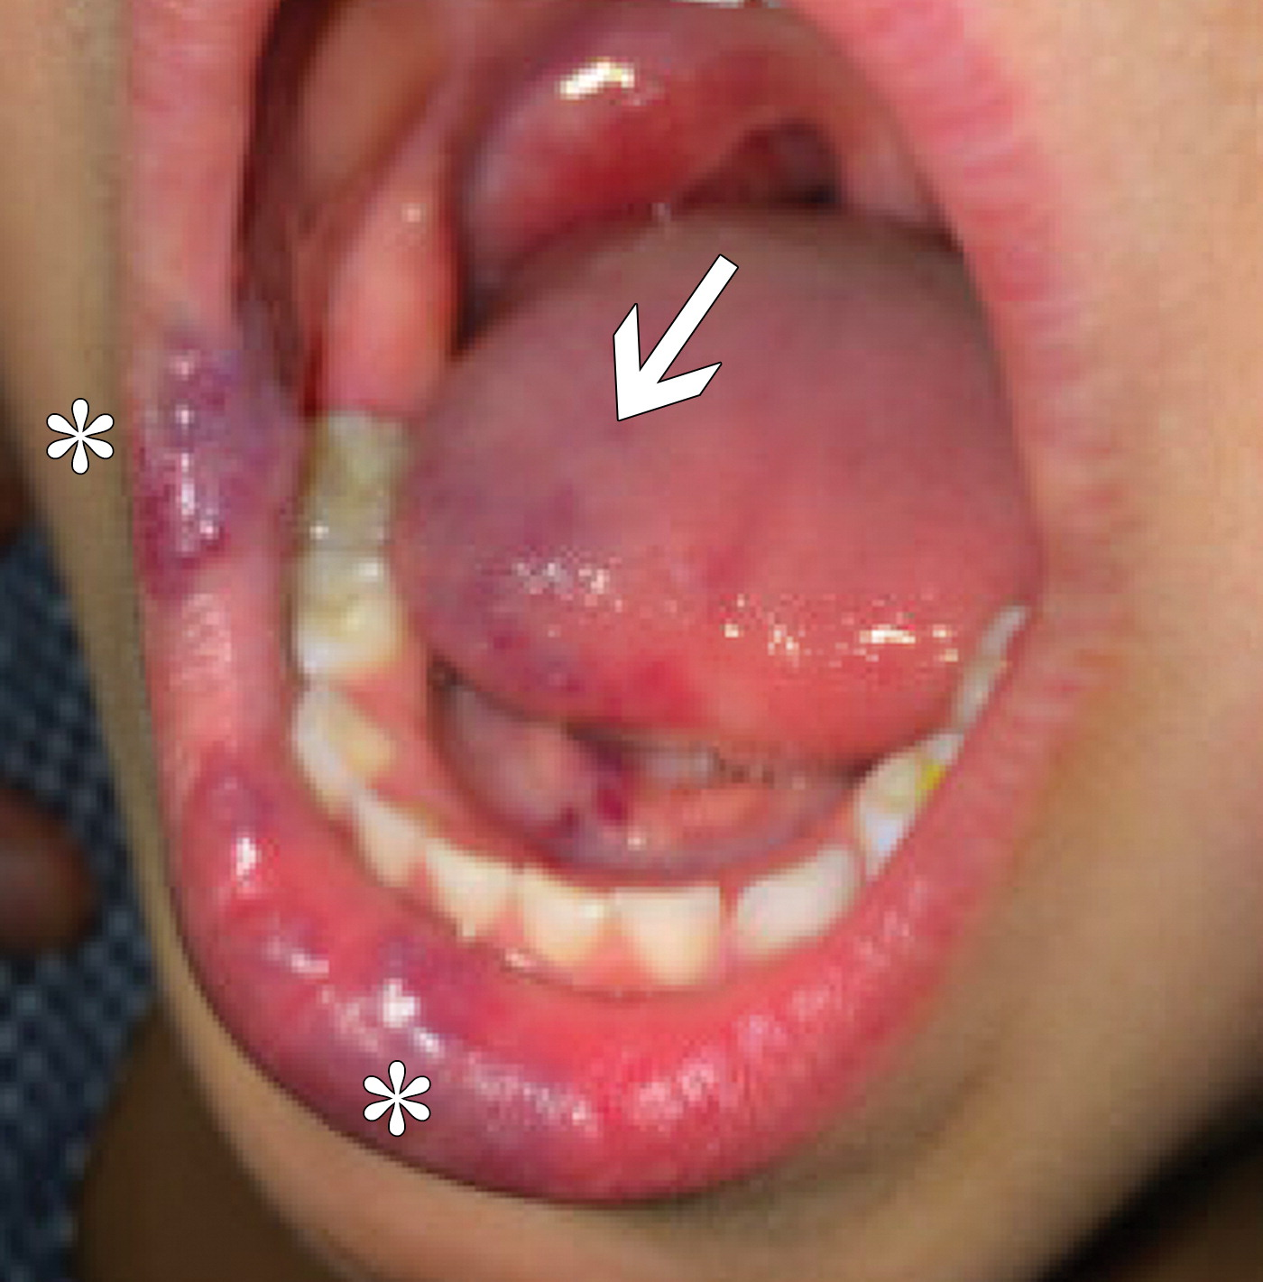
VM: companion case from literature
Figure 4a. Oral VM in a 4-year-old girl with oral lesions that have been enlarging in proportion to the patient’s growth since birth. (a) Digital photograph of the patient’s mouth shows both superficial lip (*) and lingual (arrow) blue-toned VMs.
Chapman MC. Published Online: July 08, 2019
https://doi.org/10.1148/rg.2019180128

Slide 45
VENOUS, LYMPHATIC, OR BOTH
VMs
LMs
Grow in proportion to the child
Soft, compressible blueish
Enlarge during crying or Valsalva
face, limbs, or trunk
Intraosseous lesions are common
Syndromic associations include blue rubber-bleb nevus syndrome
Enlarge with growth of the child
  Sudden hemorrhage into lesion
Appear under normal colored skin
Common in face, neck, axilla
  >75% in the neck
  Intraosseous rare
Microcystic, macrocystic, or mixed
Neck are generally macrocystic
Face, floor of the mouth, and the tongue are often microcystic

Slide 46
VENOUS, LYMPHATIC, OR BOTH…
Venous can have large venous channels with slow flow and look like cysts on US
Microcystic LMs can have tiny imperceptible cysts → “pseudo-solid”
  Beware of the “ macroglossia“ misdiagnosis clinically
Unilocular macrocystic LMs ( 1 large cyst) difficult to differentiate from any other cyst
Vascular Anomalies Clinic at Children’s National Hospital
  VM and LM management
  Tx: symptomatic or cosmetic with surgery, sclerotherapy, Sirolimus, laser ablation for superficial microcystic lesions

Slide 47
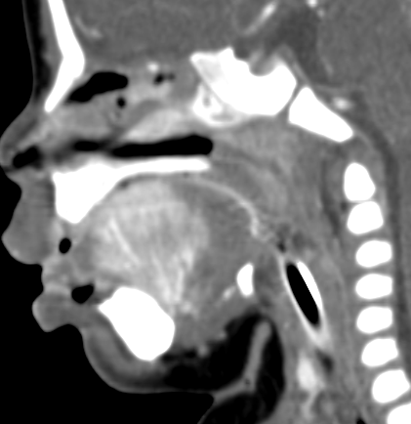
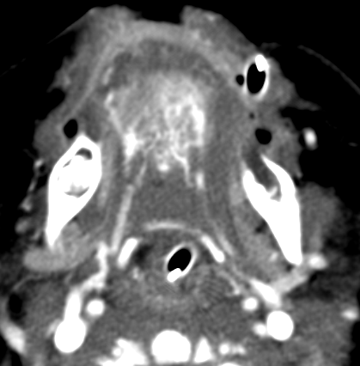
Case 9a: Hemangioma
Clinical Presentation: 78 day old with oral bleeding
Sagittal and axial post contrast CT – Intensely enhancing lesion involving anterior 2/3rds of tongue (yellow arrow). Bilateral enlarged tortuous lingual arteries supply it (red arrows)

Slide 48
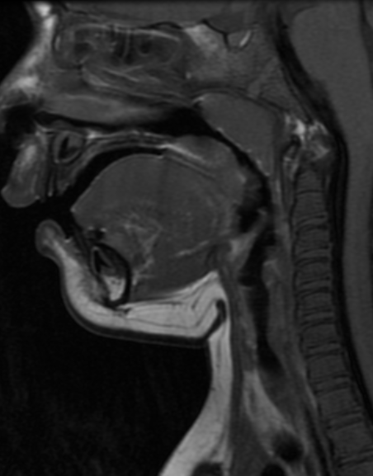


Case 9b: Hemangioma
Clinical Presentation: 24 month old with known subglottic hemangioma
Axial T2 FS: T2 Hyperintense lesion (red arrow) with flow voids (blue arrow) around the glottis
Sagittal T1 pre and Post contrast : Enhancing transglottic hemangioma (red arrow) and additional dorsal soft palate hemangioma (yellow arrow)

Slide 49


Case 9c: Hemangioma
Clinical Presentation: 18 month old male with intermittent swelling and bluish discoloration of the left upper lip and left lateral nose.
Basic Facts:
most common vascular tumor of head and neck.
Rare in oral cavity
In oral cavity lips, tongue, buccal mucosa, and palate are common sites.
Coronal T2W images – hyperintense lesion with flow voids involving upper lip and along left nare (red arrow). Sagittal Post contrast T1 W images – enhancing hemangioma (yellow arrow)

Slide 50


Case 9d: Hemangioma
Clinical Presentation: 15 month old female with left intra oral buccal lesion
Imaging:
MR is the modality of choice
Soft tissue density lesions on CT with heterogenous enhancement
MR is T1 hypointense, T2 hyperintense, with intralesional flow voids, and heterogeneous, but avid post contrast enhancement
Coronal T2W images – hyperintense lesion along left buccal region (yellow arrow). Coronal Post contrast T1 W images – heterogeneously enhancing lesion along left buccal region (yellow arrow)

Slide 51
Hemangiomas: Infantile or Congenital?
Clinical Presentation: Imaging features may overlap -- > diagnose clinically
INFANTILE
CONGENITAL
Small or absent at birth
grow rapidly, regress spontaneously
Rare at screening prenatal US
Regress with β-blocker therapy
Skin of head and neck are the most common locations
PHACES syndrome (posterior fossa anomalies, facial hemangiomas, arterial anomalies, cardiovascular anomalies, eye anomalies, sternal clefting and/or supraumbilical raphe).
Less common, but more likely to be seen at prenatal screening US
proliferative phase in utero, full size at birth, and can remain stable, partially resolve, or fully involute by 1st year of life
Initial watch & wait
NICH lesions: laser therapy for skin lesions, embolization, or surgery may be considered
GLUT 1 +

Slide 52



Case 10: Melanotic Neuroectodermal
Tumor of Infancy “MNTI”
Clinical Presentation: gray discolored mass in anterior maxilla, noticed at 2 months of age, presented to care at 3 months, doubled in size over 1 week, centered left paramedian maxilla
Sagittal CT image : expansile soft tissue mass ( yellow arrows), centered in alveolar ridge of maxilla
Coronal and axial CT images- Sclerosis and destruction of the adjacent bone

Slide 53
Case 9: Melanotic Neuroectodermal tumor of infancy
Very rare
benign but locally aggressive neoplasm, high recurrence rate
Neural crest cells origin
blue or blue-black appearance and, occasionally, an ulcerated surface
RAPID GROWTH !!!
Usually infants of less than 1 year of age.
Maxilla, less common in skull, mandible, brain and other extracranial sites

Slide 54


Slide 55


Slide 56

MNTI: Example from the literature
Figure 1. A, Extraoral view showing enlargement of left upper lip and paranasal region. B, Intraoral photograph showing firm swelling of upper left alveolus.
Gonçalves et al. Melanotic Neuroectodermal Tumor of Infancy. J Oral Maxillofac Surg 2010.

Slide 57


Slide 58


Slide 59



Postoperative changes of bilateral subtotal maxillectomy.

Slide 60
TAKE HOME: Some help in diagnosis
LOCATION, LOCATION, LOCATION
AGE AT PRESENTATION
CLINICAL & RADIOLOGIC APPEARANCE
CLINICAL DX: EPULIS / GRANULAR CELL TUMOR
RADIOLOGIC AND PATHOLOGIC DX:
  Foregut duplication (MRI)
  Dermoid ( MRI) , Thyroid (MRI or CT)
  Lymphatic malformations, venous malformations, hemangiomas -- > MRI
  Rhabdomyosarcoma, Teratoma, and MNTI (CT, MR, PET)

Slide 61
Spectrum of Congenital Oral Lesions
FOREGUT
DUPLICATION
CYST
LYMPHATIC MALFORMATION
EPULIS
TERATOMA
HEMANGIOMA
DERMOID
VENOUS MALFORMATION
RHABDOMYOSARCOMA
MNTI
THE LOST THYROID
Notes:
EPIGNATHUS TERATOMA
SUBLINGUAL MIDLINE - DERMOID with fat nodule or sac of fat marbles appearance on MRI
VASCULAR MALFMORMATIONS – sometimes clinically obvious but need extent of lesion by MRI
Rhabdomyosarcoma, toddler rather than infant
MNTI – need to recognize quickly in maxilla
Thyroid migrational abnorlities, usually not clinically significant unless then thyroid is missinor cyst gets infected

Slide 62
TAKE HOME: PRENATAL EXPECTATIONS
Size, location, lesion growth during pregnancy
Prenatal predictors of potential oropharyngeal airway obstruction
  Polyhydramnios
  Small stomach bubble
  Abnormal head position
  Airway deviation, impaired swallowing, nasopharyngeal obstruction
Large masses at risk of hydrops
Airway obstruction
  emergent airway present in delivery room by ENT (large tongue lesions?)
  plan EXIT procedure for teratomas
  LM usually not an airway issue

Slide 63
Thank you
Aparna Yepuri, Pediatric Radiology Fellow
Gilbert Vezina, Pediatric Neuroradiologist
QUESTIONS ?

